Slide 1
About the Course
The long 20th century will in all likelihood be seen in the future as the watershed in human experience:
Nine aspects:
History was primarily economic—and that was true for the first time…
Explosion of wealth: 2%+ per year…
Cornucopia of technology…
Demographic transition…
Feminist revolution…
Empowered tyrannies…
Wealth gulfs…
Inclusion and hierarchy attenuation…
Mismanagement and insecurity…
Humanity is unlikely to see as transformative—for good and ill, but mostly for good, so far at least, I think—a century again…

Slide 2
Coronavirus!
Calls are Carol Christ’s…
She has made the call: classes are now moved online: I am busy adding audio to slide files
That said:
If you are coughing and sneezing, stay home! Email me and we will give you extra-credit points…
Otherwise, there are powerful herd-animal benefits to coming to lecture
(& to talking about course material with your friends: you need to convince your brain that these concepts are useful, & it should keep them)
Washington State has been doing an intensive flu screening, so they know stuff:
They guess: 1 in 1000 people in WA has coronavirus right now
Half of them have no symptoms
Asymptomatic transmission means that we cannot contain this without shutting society down
Cases doubling every 5 days
Means that by the end of March 1 in 45 people in WA will have it…
April will be epidemic month
In the end, 30%-70% of us will test positive
&, worldwide, 20 million people are likely to be dead
Our hope is to stretch out this process as long as possible, so that health providers are not totally overwhelmed

Slide 3

MOAR Coronavirus!
It’s a Thing for Geezers!
Mortality for the Youngs very low…
It’s the flu for them…

Slide 4
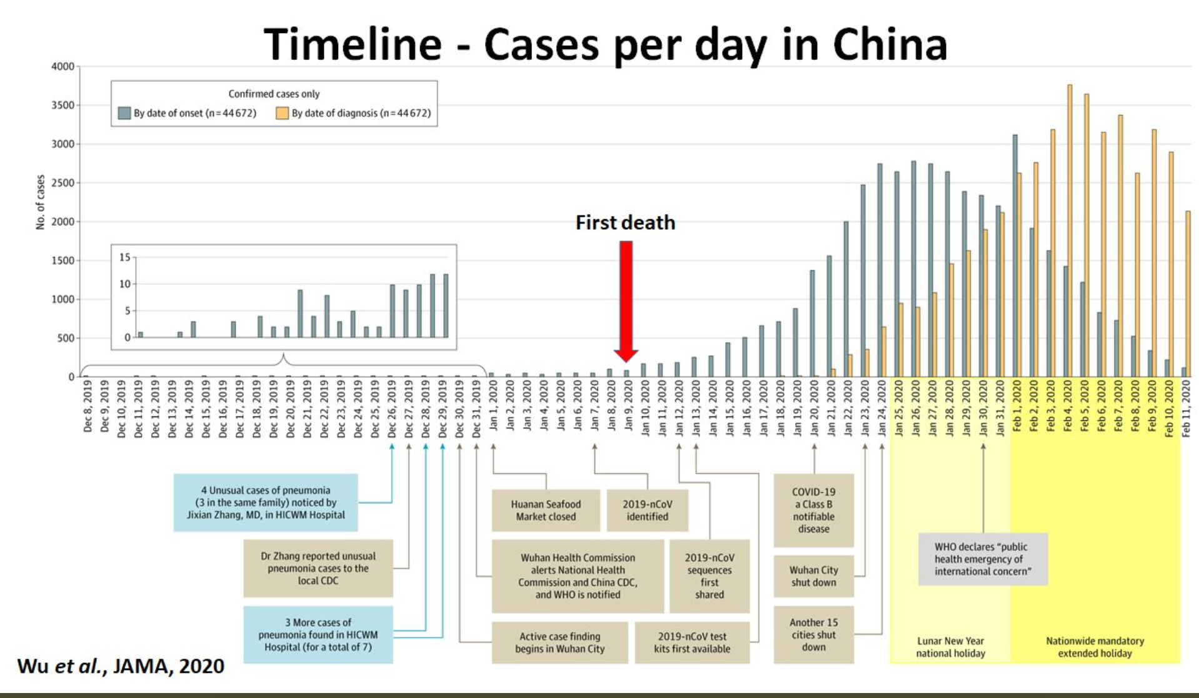
MOAR Coronavirus! II
China Beat It!
Shut down Wuhan when 200 cases per day
That seems to have been a good decision

Slide 5

MOAR Coronavirus! III
When Is It Appropriate to Move on This?
Immediate social distancing…
Self-isolate if you have a cough and a fever…
Hope that warmer temperatures will do to this what they did to SARS…
Otherwise, when do you want to start spreading out transmission. It seems that early is as good as later…

Slide 6
U.C. Berkeley: Economics 115: Spring 2020
20th Century Economic History: Lecture 10: Cold War
Brad DeLong
Department of Economics and Blum Center, U.C. Berkeley; and WCEG
delong@econ.berkeley.edu
last revised: 2020-03-09
for delivery: M 2020-03-09 17:00 HMMB390
<https://bcourses.berkeley.edu/courses/1487684>
<https://github.com/braddelong/public-files/blob/master/econ-115-lecture-10.pptx>

Slide 7
Takeaways from Last Time
From Fascism & WWII
Come up with your own five takeaways from our look at interwar (between World Wars I & II) fascism and World War II…

Slide 8
Preview
The Cold War
Takeaways from Last Time
Preview
Administration
The Cold War: There Was Not Supposed to Be One
The Korean War
Review: Broad sweep
Consequences: After the Korean War
Russia Sits Down
Takeaways
Preview

Slide 9
Econ 115: Administration: Office Hours &c.
DeLong: Office Hours
M 11:10-12:40, Blum Hall 200B
T 11:15-12:00, Blum Hall 200B
Email <delong@econ.berkeley.edu> for a virtual appointment
Read: DeLong, chapter 15
Slides: <https://github.com/braddelong/public-files/blob/master/econ-115-lecture-10.pptx>
Do: Assignments on suspension as we figure out what to do with the midterm…
Memo: bCourses website <https://bcourses.berkeley.edu/courses/1487684>

Slide 10
Reminding You:
In the abortive German communist revolution of January 1919, Petty Officer Lemmgen and his forces failed to take control of the offices of the Ministry of War because:
Lieutenant Hamburger objected that the document authorizing him to do so was handwritten, and Lemmgen returned to Revolutionary HQ to get the document typed.
Lieutenant Hamburger objected that the document authorizing him to do so was not signed, and Lemmgen returned to Revolutionary HQ to get the document signed.
Lieutenant Hamburger objected that the Revolutionary Council that had produced the document was a bunch of traitors.
Lieutenant Hamburger objected that the Revolutionary Council was only made up of a minority of the leaders of the German Socialist Party.
None of the above.

Slide 11
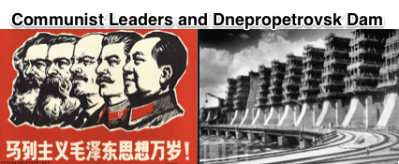

How Important Was the Soviet Union for Twentieth Century Economic History?
How much time should I spend on the Soviet Union in this class?
A dead end
Very important outside the United States…
Not terribly important for America…
Socialism never got anywhere in America—Jack London: not proletarians but “temporarily embarrassed millionaires”
Virginia and Kentucky nationalism strongly opposed to “big government”
New-England nationalism not strongly in favor
Cold War very important for America, however…
1:30
Notes:
How much time should I devote to the Soviet Union in this 20th-century Economic History class? The Soviet union—and much more so Maoist China—plus their empires were an off a lot of people, and really existing socialist regimes ruled fro generations. But they were not models of development or the roads to the future, but rather horrible warnings and dead ends. Moreover, really existing socialism was never very popular in the United States. It was too close to being an obvious tool of Russian foreign policy imperialism. All forms of socialism were working against the grain in the United States: as Jack London said, in the United States we had no proletarians but rather everybody was a temporarily embarrassed millionaire. The Virginia and the Kentucky nationalisms of America were strongly opposed to "big government", And the Massachusetts nationalism plays to much too much stress on the individual conscience and on marching toward utopia listening to your own personal drummer for the regimentation to be a positive.
But the cold war from 1947 to 1989 was very important to America into the world. So let me focus on the Cold War.

Slide 12
There Was Not Supposed to Be a Cold War
Leninist theory was very clear:
Capitalism needed imperialism to moderate crises
Imperialism led to intra-imperialist war
War led to the advance of socialism
Hence step back, rebuild, wait for the Anglo-American War, & then cash in your chips…
That ought to have been Stalin’s plan…
2:25
Notes:
The Cold War was the 1947-1989 largely peaceful contest for global influence and predominance between the United States and the Soviet Union. There was not supposed to be a Cold War. Marxist theory—at least that branch of Marxist theory that became the cultic revealed religion guiding at least the official pronouncements of the governments ruling from behind Stalin's Iron and Mao’s Bamboo Curtains—was very clear on what was to come:
Capitalism, in Lenin’s view, needed imperialism. Imperialism produced militarization with its enormous demand for weapons and colonies that offered captive markets. These were essential to preserve near-full employment, and so stave off the catastrophic economic crises—like the Great Depression—that would otherwise produce communist revolution. But imperialism also produced war. Thus capitalism was staving off revolution from economic catastrophe by courting revolution through political-military catastrophe.
As Lenin’s successor Stalin saw it, the capitalist-imperialist powers had successfully delayed revolution from the late 1890s though imperialism and militarism, but had then fallen into the catastrophe of World War I. That had brought Lenin to power in Russia. Then the rise of fascism—Mussolini in Italy, Hitler in Germany, Franco in Spain, Petain in France, Tojo in Japan—led to the second great imperialist war, World War II, worse than the first. In the aftermath really existing socialism expanded across Europe to the Elbe and the Adriatic—although not before Hitler’s legions had nearly destroyed the Soviet Union.
Thus their task after World War II were to build up militarily to defend the territories of really existing socialism, to build up economically to realize the promise of socialism and to demonstrate its superiority to capitalism, stand ready to assist socialist revolutions, and otherwise lie low.
If they accomplished those tasks, then the logic of imperialist-militarist-capitalism would start to work again. Provided the really existing socialist block kept its head down and survived, it would expand again after the next intra-imperalist war. That ought to have been the Soviet Union’s strategy: defend, rebuild, and wait, for history was on their side. Waging a cold war was not the strategy.

Slide 13
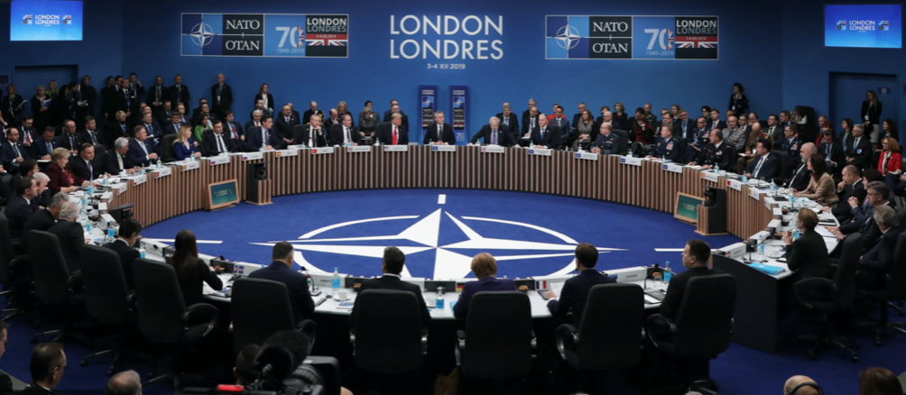
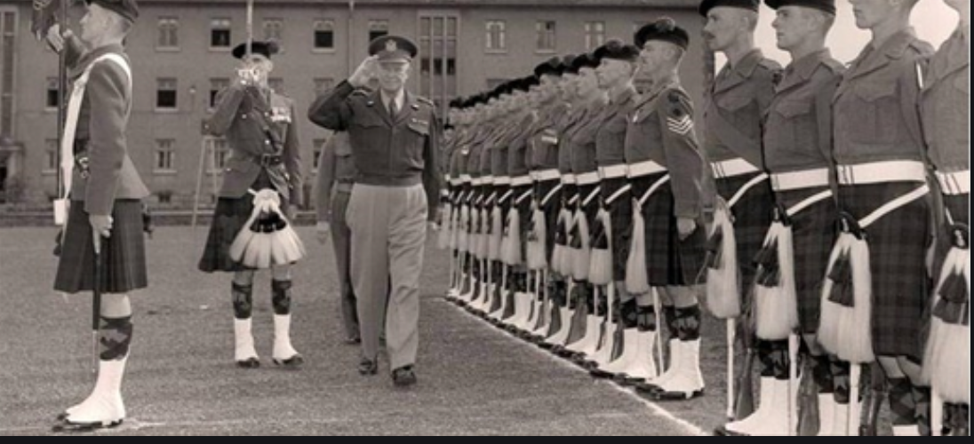
The NATO Alliance Did Not Want a Cold War Either
Post-WWII demobilization
Isolationism
The “West” saw itself as secure
Post-WWII opposition to the Marshall Plan, etc.
Stalin’s patience
But Czechoslovakia
And Mao
The U.S. military’s wish list: NSC-68
2:26
Notes:
On the other side of what was to become the Iron Curtain, there was little appetite for confrontation. Isolationist currents in America were not as strong as they had been after World War I, but they were strong. Western Europe was exhausted. Britain was seeking to find a role, rather than wishing to roll back really-existing socialism. A U.S. General Patton might muse about taking his 3rd Army’s tanks and driving to Moscow, but that was far beyond the pale for any sane and most other North Atlantic politicians. Militarism to send millions of young men to die at the front while civilians died under bombing was in bad odor.
West of what was to become the Iron Curtain, really-existing socialism was not very attractive. Cadres had been decimated at the start of World War II by the Stalin-Hitler pact. And really-existing socialism became more unattractive the more closely outsiders were able to scrutinize it. Pus it ran into the buzzsaw of nationalism. It became more and more clear that allegiance to really-existing socialism required submission to or absorption into the latest incarnation of Russian Empire.
Stalin had a taste for snatching up territory when he thought it could be taken cheaply—starting with the suppression of the Mensheviks in Georgia at the end of the Russian Civil War. But after World War II Stalin curbed his appetite. He did not impose a really-existing socialist government on Finland, but let it remain democratic as long as it was disarmed and joined no potentially anti-Soviet alliances—and as long as its government was riddled with Soviet agents. He cut off support to the communist party in Greece—largely. He counseled Mao to join a coalition with Chiang Kai-shek (the Cantonese romanization of Jiang Jieshi) and wait.
But in 1948 Stalin could not resist snatching up Czechslovakia in a coup d’etat. And Mao ignored Stalin, defeated Chiang Kai-shek, and chased him and his Guomindang to Taiwan. No doubt Stalin heard whispers that he was being overly cautious, and had lost his nerve as a result of the shocks of World War II. The U.S. government had plans to wage a cold war—boosting defense spending to 10% of national income and deploying U.S. armies as tripwires and more-than-tripwires all across the globe. But those plans remained fantasies for unimaginable contingencies—until the Korean War.

Slide 14
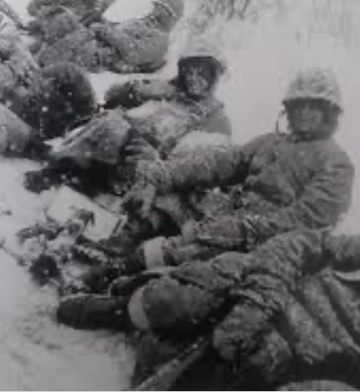
The Korean War
The U.S. right wing was conflicted
Post-WWII opposition to the Marshall Plan, etc.
Yet, also: fight Mao! Unleash Chiang Kai-Shek! McCarthyism!
Isolationism abroad, plus red-baiting at home
But Stalin could not stick to his plan…
North Korea and Kim Il Sung…
Chinese intervention
2:26
Notes:
Stalin could not stick to his plan. In 1950 the strongman Kim Il Sung, whom Stalin had installed in North Korea at the end of World War II when the Russians occupied the north off the country above and the Americans occupied the south below the 38th parallel, begged him for tanks and support to take over the south. There were then no U.S. garrisons in the south. The U.S. had declined to send troops to support Chiang Kai-shek—it had sent weapons, but had stopped when it realized that the most effective way to arm Mao’s People’s Liberation Army was to ship weapons of the Guomindang. Moreover, the U.S. was for decolonization—the British out of India, the Dutch out of Indonesia. While the U.S. was happy to provide logistical support to the French war against the communist Vietminh in southeast Asia, it wanted the French to promise independence rather than further colonial rule as the endpoint. U.S. strategic thinking was that in Asia it should use air and sea rather than land power as its weapons.
In June 1950 Stalin let slip the dog of war that was Kim Il Sung and his Soviet-trained and supplied army. The Korean War began, as the U.S. surprised Kim Jong Il, Stalin, Mao, and itself by rallying the United Nations to send an army, largely provided by the United States but formally a force of the United Nations as an organization, to defend the order that had been established in the American zone of occupation that was to become South Korea—and perhaps create a single unified Korean nation as well.
Fighting raged all across the Korean peninsula, from near the Yalu River in the north to the port of Pusan in the south. South Koreans and North Koreans fought on land; Americans fought on land, in the sea, and in the air; Chinese fought on land; Russians fought in the air (with 350 planes shot down). In three years, somewhere between one and two million Korean civilians died, 5% to 10% of the population; perhaps 400000 South Koreans were abducted from their homes and taken to North Korea; and the military dead and missing were, roughly: 500000 Chinese, 300000 North Koreans, 150000 South Koreans, 50000 Americans, 1000 British, 1000 Turkish, 500 Canadian, 400 Australian, 300 Russian, 250 French, 200 Greek, 150 Columbian, 130 Thai, 120 Ethiopian, 120 Dutch, 100 Belgian, 90 Filipino, 30 South African, 30 New Zealand, 3 Norwegian, 2 Luxembourgese, and 1 Indian soldier. The U.S. Air Force dropped half a million tons of bombs during the war—that is 40 pounds of bomb for every North Korean then alive.
The United States did not use its nuclear weapons—it was a war, but it was a limited war. U.S. theater of operations commander Douglas MacArthur asked for their use at the end of 1950 when Chinese People’s Liberation Army attacks forced the United Nations’ army to retreat from near the Yalu River back to south of Seoul. The Pentagon and U.S. President Harry Truman refused. Starting in March 1951, with the battlefront stabilized near the 38th parallel that had divided North and South Korea before the war, the Pentagon and Truman began to seek a ceasefire and a return to the status quo ante bellum—to the state of things before the war—leaving neither victor nor vanquished.
Yet the war dragged on for two more years. And the casualties mounted: military comm https://www.britannica.com/event/Korean-War/North-to-the-Yalu anders on both sides thought that leverage at the peace table was to be gained by attritting their adversary’s forces and depriving them of jumping-off points in case the war was widened. Key, in the minds of United Nations commanders Matthew Ridgway and James van Fleet, was the “Iron Triangle” about 12 miles on each side, near the 38th parallel, running from Pyonggang in the north to Kimhwa in the east to Chorwon in the west.
The ultimate sticking point in the negotiations, however, was the status of prisoners of war. The Chinese and North Koreans wanted all prisoners of war returned to their countries of origin. The United Nations and the South Koreans wanted to keep prisoners of war who wished not to return from being forced to do so. On March 5, 1953, Soviet Dictator Josef Stalin died of a stroke. Stalin’s heirs decided that the Korean War was pointless and should end. Mao’s negotiators accepted the United Nations’s prisoner-of-war position. 10000 of 15000 Chinese prisoners of war decided not to return to China 5000 or 70000 North Korean prisoners of war decided not to return to North Korea. 327 South Korean prisoners of war decided to stay in North Korea, as did 21 Americans and 1 Briton. 18 of the 22 eventually returned to the western bloc. However 8000 missing from the United Nations forces (and 80000 missing from the South Korean forces) remained unaccounted for. Most of them surely died in battle, but…
And so the current state of things—with North Korea under the autocratic rule of the current Kim dynasty which has presided over the worst famine of the post-World War II period, and with South Korea independent and now a rich industrial power and a democracy—began.

Slide 15
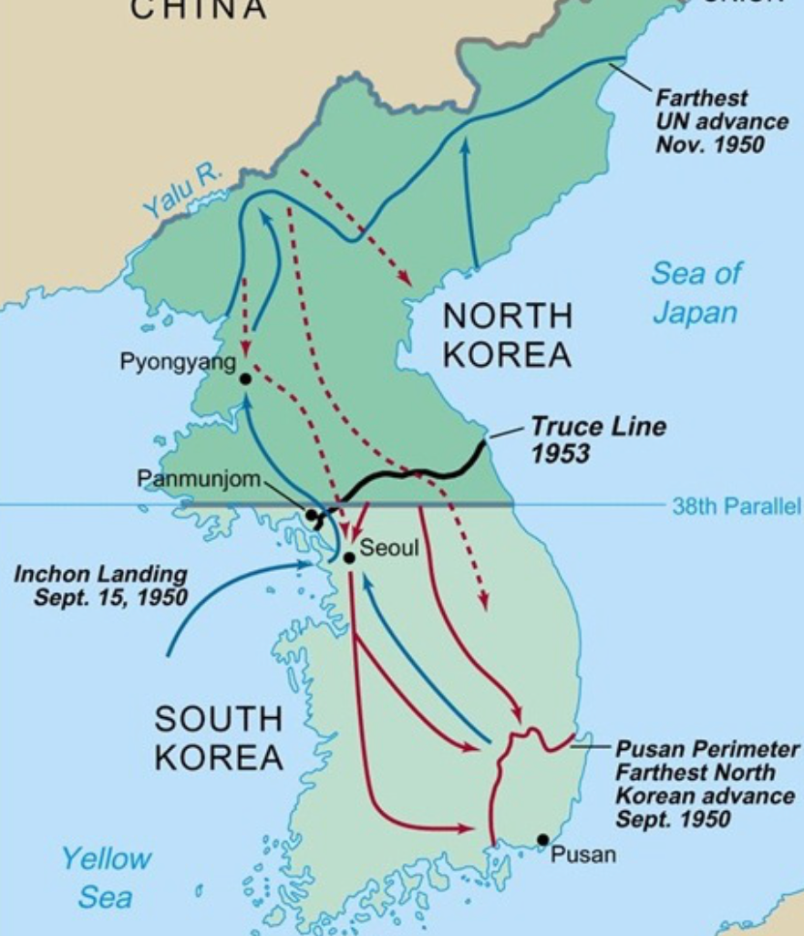
The Korean War
No U.S. use of nuclear weapons
A limited war
Dismissal of U.S. commander MacArthur
Sought a return to the status quo ante
The war dragged on…
The U.S. response and NSC-68
10% of GDP in military…
War dragged on for three years
Settlement as essentially a return to the status quo ante bellum
2:34
Notes:
Stalin could not stick to his plan. In 1950 the strongman Kim Il Sung, whom Stalin had installed in North Korea at the end of World War II when the Russians occupied the north off the country above and the Americans occupied the south below the 38th parallel, begged him for tanks and support to take over the south. There were then no U.S. garrisons in the south. The U.S. had declined to send troops to support Chiang Kai-shek—it had sent weapons, but had stopped when it realized that the most effective way to arm Mao’s People’s Liberation Army was to ship weapons of the Guomindang. Moreover, the U.S. was for decolonization—the British out of India, the Dutch out of Indonesia. While the U.S. was happy to provide logistical support to the French war against the communist Vietminh in southeast Asia, it wanted the French to promise independence rather than further colonial rule as the endpoint. U.S. strategic thinking was that in Asia it should use air and sea rather than land power as its weapons.
In June 1950 Stalin let slip the dog of war that was Kim Il Sung and his Soviet-trained and supplied army. The Korean War began, as the U.S. surprised Kim Jong Il, Stalin, Mao, and itself by rallying the United Nations to send an army, largely provided by the United States but formally a force of the United Nations as an organization, to defend the order that had been established in the American zone of occupation that was to become South Korea—and perhaps create a single unified Korean nation as well.
Fighting raged all across the Korean peninsula, from near the Yalu River in the north to the port of Pusan in the south. South Koreans and North Koreans fought on land; Americans fought on land, in the sea, and in the air; Chinese fought on land; Russians fought in the air (with 350 planes shot down). In three years, somewhere between one and two million Korean civilians died, 5% to 10% of the population; perhaps 400000 South Koreans were abducted from their homes and taken to North Korea; and the military dead and missing were, roughly: 500000 Chinese, 300000 North Koreans, 150000 South Koreans, 50000 Americans, 1000 British, 1000 Turkish, 500 Canadian, 400 Australian, 300 Russian, 250 French, 200 Greek, 150 Columbian, 130 Thai, 120 Ethiopian, 120 Dutch, 100 Belgian, 90 Filipino, 30 South African, 30 New Zealand, 3 Norwegian, 2 Luxembourgese, and 1 Indian soldier. The U.S. Air Force dropped half a million tons of bombs during the war—that is 40 pounds of bomb for every North Korean then alive.
The United States did not use its nuclear weapons—it was a war, but it was a limited war. U.S. theater of operations commander Douglas MacArthur asked for their use at the end of 1950 when Chinese People’s Liberation Army attacks forced the United Nations’ army to retreat from near the Yalu River back to south of Seoul. The Pentagon and U.S. President Harry Truman refused. Starting in March 1951, with the battlefront stabilized near the 38th parallel that had divided North and South Korea before the war, the Pentagon and Truman began to seek a ceasefire and a return to the status quo ante bellum—to the state of things before the war—leaving neither victor nor vanquished.
Yet the war dragged on for two more years. And the casualties mounted: military comm https://www.britannica.com/event/Korean-War/North-to-the-Yalu anders on both sides thought that leverage at the peace table was to be gained by attritting their adversary’s forces and depriving them of jumping-off points in case the war was widened. Key, in the minds of United Nations commanders Matthew Ridgway and James van Fleet, was the “Iron Triangle” about 12 miles on each side, near the 38th parallel, running from Pyonggang in the north to Kimhwa in the east to Chorwon in the west.
The ultimate sticking point in the negotiations, however, was the status of prisoners of war. The Chinese and North Koreans wanted all prisoners of war returned to their countries of origin. The United Nations and the South Koreans wanted to keep prisoners of war who wished not to return from being forced to do so. On March 5, 1953, Soviet Dictator Josef Stalin died of a stroke. Stalin’s heirs decided that the Korean War was pointless and should end. Mao’s negotiators accepted the United Nations’s prisoner-of-war position. 10000 of 15000 Chinese prisoners of war decided not to return to China 5000 or 70000 North Korean prisoners of war decided not to return to North Korea. 327 South Korean prisoners of war decided to stay in North Korea, as did 21 Americans and 1 Briton. 18 of the 22 eventually returned to the western bloc. However 8000 missing from the United Nations forces (and 80000 missing from the South Korean forces) remained unaccounted for. Most of them surely died in battle, but…
And so the current state of things—with North Korea under the autocratic rule of the current Kim dynasty which has presided over the worst famine of the post-World War II period, and with South Korea independent and now a rich industrial power and a democracy—began.

Slide 16
Review: Broad Sweep
What was the growth rate of ideas in the industrial core of the world economy over 1870-2020?
About 2.3%/year
About 0.9%/year
About 0.23%/year
About 4%/year
None of the above

Slide 17
Review: Broad Sweep
What was the growth rate of ideas in the industrial core of the world economy over 1770-1870?
About 2.1%/year
About 0.45%/year
About 0.15%/year
About 0.04%/year
None of the above

Slide 18
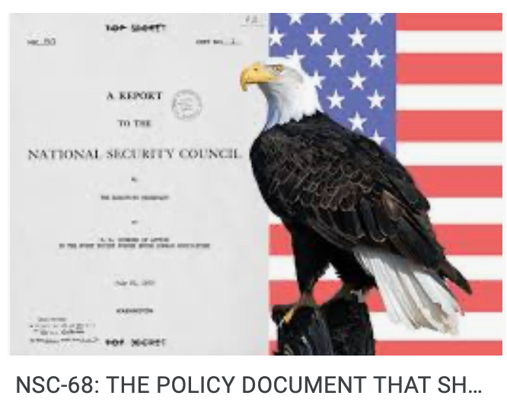
Consequences: After the Korean War
NSC-68
10% of GDP in military…
Western Germany looked a lot like South Korea
A full U.S. army in Europe
Containment
Projecting power
2:29
Notes:
n the aftermath of the Korean War, the United States saw itself as having a new role.
To start with, western Germany looked analogous to Korea—a country divided by what had originally been intended to he a military occupation boundary but had become permanent. That it could not be snatched up cheaply was not wholly reassuring, because Stalin had also exhibited a certain degree of bad judgment: in addition to allowing Kim Il Sung to launch the Korean War, there was the unsuccessful attack on Finland in 1939, and there was mother of all miscalculations, the belief that the way to deal with Hitler was to become his ally and then watch Nazi Germany and the western democracies exhaust themselves in trench warfare. Perhaps Stalin’s successors would exhibit a similar appetite for conquest on the cheap, and a similar weak grasp of geopolitical realities.
As a result of the Korean War, by the middle of the 1950s there was a full U.S. army—corps, divisions, airwings, and the standard enormous logistical tail—sitting in West Germany waiting for Stalin’s successors to attempt in Germany what Stalin, Mao, and Kim Il Sung had attempted in Korea: the reunification by force of a country that had been divided in the armistice that ended World War II. Stalin’s successors were largely unknown: the only solid thing about them was that they had flourished under Stalin and shot a couple of their own number in the power struggle that followed Stalin’s death. By the mid-1950s the U.S. was spending on the Cold War a huge scale. What had before June 1950 been the fantasies of national security staffers and planners became reality. They pushed U.S. national security spending up to 10% of national income after the Korean War had come to an end provided a strong floor to demand and employment in the United States as well.
A good deal of this spending was for the U.S. to project its Cold War military power far beyond its borders. U.S. bases and troops found themselves permanently deployed on every continent save Antarctica. Roughly three-quarters of a percent of U.S. national product in the mid 1950s was “net military transactions”—expenditures abroad by the U.S. army which generated no dollar inflow. In Europe, the increase in net U.S. military transactions did much to offset the winding-down of the Marshall Plan: the forces of the Supreme Allied Commander, Europe, of the North Atlantic Treaty Organization thus provided one more secure source of demand for European production during Europe’s booms in the 1950s and 1960s.

Slide 19
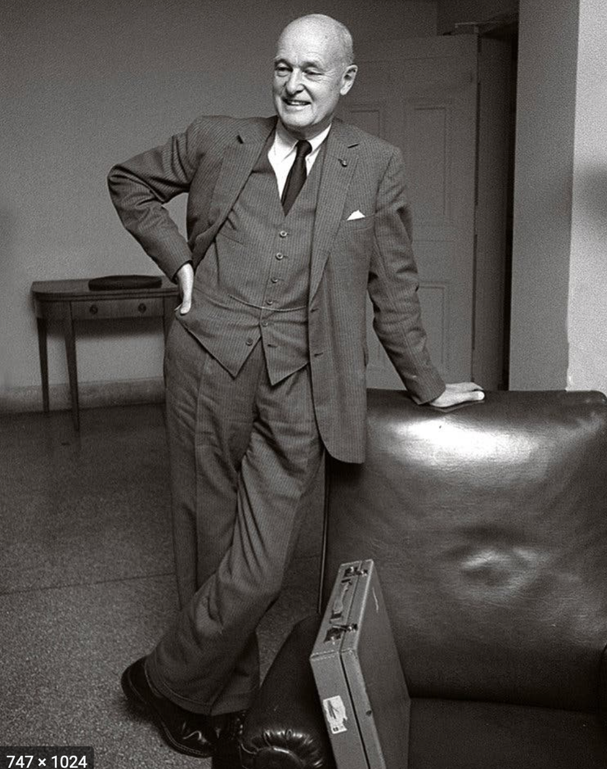
Containment and Destabilization
Containment
Projecting power
Destabilization
Defensive weapons can look pretty offensive
“Peaceful coexistence”
Soviet hopes
George Kennan
Meet force with resistance
Play the long game
A suitable challenge for America to face with confidence
Become and remain a City Upon a Hill
2:29
Notes:
Nuclear forces that U.S. planners regarded as perhaps inadequate to deter a Russian nuclear strike or conventional-force invasion of western Europe struck Russian planners as dangerously close to the forces the U.S. would need to wage and win a nuclear devastation or conventional occupation of Russia. And all Russian planners remembered the burning of Moscow by the Crimean Tartars in 1571, the occupation of Moscow by the Poles in 1610, the invasion by the Swedes in 1709, the occupation of Moscow by the French in 1812, the German-dictated Peace of Brest-Litovsk in 1918, and Hitler’s invasion in 1941. From 1956 on the formal policy of the Soviet Union was “peaceful coexistence”. The Russians would, of course, continue to support just revolts against colonialism and capitalism. But war between the superpowers? Off the table. The U.S. and the U.S.S.R. would coexist. Really existing socialism would triumph in the end, of course. But its triumph would be by example, not by military force.
From the other side of the hill, the U.S. policy became one of “massive retaliation”: “contain[ing] the mighty landpower of the communist world… by be[ing] willing and able to respond vigorously at places and with means of its own choosing”. This policy, pointedly, did not take a nuclear-weapon response to a conventional provocation off the table, and did not restrict retaliation and deterrence to the particular theater of conflict.
The keyword, I believe, is “contain”: the U.S. and indeed the western NATO alliance policy for the Cold War was one of containment. As U.S. diplomat George Kennan put it, the right strategy was one of “holding the line and hoping for the best”, for since “ideology convinces the rulers of Russia that truth is on their side and they they can therefore afford to wait”, it was the case that “Soviet pressure… can be contained by the adroit and vigilant application of counter-force at a series of constantly shifting geographical and political points”.
And there was more: “the issue of Soviet-American relations is in essence a test of the overall worth of the United States as a nation among nations”.
Thus:
>The thoughtful observer of Russian-American relations will find no cause for complaint in the Kremlin's challenge to American society. He will rather experience a certain gratitude to a Providence which, by providing the American people with this implacable challenge, has made their entire security as a nation dependent on their pulling themselves together and accepting the responsibilities of moral and political leadership that history plainly intended them to bear…
If only the United States could, Kennan believed, truly be a City Upon a Hill. If only it could, as John Winthrop had preached back in 1630: “follow the counsel of Micah, to do justly, to love mercy, to walk humbly with our God” so that “he shall make us a praise and glory that men shall say of succeeding plantations, ‘may the Lord make it like that of New England’…”—then the U.S. and the western NATO alliance would have nothing to fear from the Cold War.

Slide 20
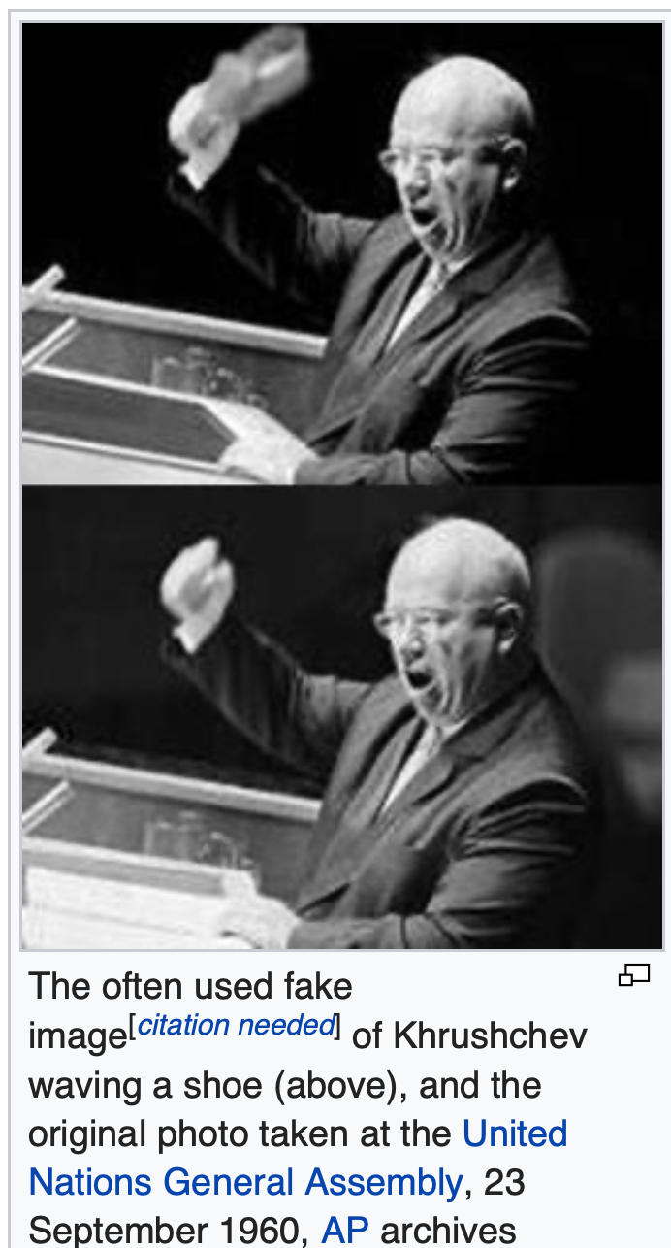
“We Will Bury You”
Containment as American policy
Pursued with confidence
Except possibly by Kissinger
Confidence on the other side: Khrushchev
Nobody in Russia wanted a WWIII
The “Third World”
Opportunities
Nehru, Sukarno, Tito
Threats
Soviet: East Germany, Hungary , Czechoslovakia, Afghanistan in 1978
U.S.: Iran and Guatemala in 1954, Cuba in 1961, Chile in 1973, Nicaragua in 1981, Grenada in 1983.
Cold War turning genuinely hot: Korea (5 million dead), Vietnam (2.5 million dead), Ethiopia (1.5 million dead), Angola (500000 dead), and more.
Governments that attack society: Indonesia, Khmer Rouge
4:17
Notes:
The Americans who ran foreign policy overwhelmingly agreed. The only possible exception was 1969-1976 Secretary of State Henry Kissinger and his erratic boss President Richard Nixon. Kissinger’s international-relations professor colleague Stanley Hoffman believed that “Henry, in his melancholy, seems to walk with the spirit of Spengler at his side”; and Admiral Elmo Zumwalt said that Kissinger talked to him about how America was part of a civilization that had seen its best days and needed to accommodate the rising power of Russia, which was a Peloponnesian War-era “Sparta to our Athens”. The others saw no reason to panic.
Soviet paramount leader Nikita Khrushchev said the same thing, but less… diplomatically, in 1956: “Whether you like it or not, history is on our side. We will bury you.” Probably the Russian “Мы вас похороним” would have been better translated as: “we will be the ones who will dig your grave” or as “we will outlast you”. Later on Khrushchev clarified: “I once said, ‘We will bury you’, and I got into trouble with it. Of course we will not bury you with a shovel. Your own working class will bury you.” The Soviet Union had lost perhaps 27 million people killed and starved in World War II. Nobody in it wanted a World War III.
For leaders and would-be leaders of both independent and colonized nations and nations-to-be during the first post-World War II generation, the Cold War was, more often than not, a blessing. Leaders could press the United States to encourage Britain and France to accelerate decolonization. Before independence, they could observe that if decolonization was delayed, the Russians and the Chinese would use the grievances justly felt by the colonized to build support for insurgencies that would add that nation to the Communist Bloc. After independence, they could declare themselves “nonaligned”, as the movement started at the Bandung Conference in Indonesia by then-Indonesian strongman Sukarno and then-Indian Prime Minister Nehru was called. Nonaligned nations could then call for bids of support from both sides in the Cold War. The hotter and more important the Cold War, the more both sides would be willing to spend to support a nonaligned government that was trying to decide what its political and economic system should be.
On the other hand, the hotter the Cold War, the more likely it was that a government or a popular movement trying to steer its own course would be pulled up short by the choke-chain of one of the superpowers, and people would die. Yugoslavia and Finland managed to pursue their own paths—but the Red Army stepped in to enforce the party line and discipline in East Germany in 1953, in Hungary in 1956, in Czechoslovakia in 1968, Afghanistan in 1978. The U.S. sponsored coups or sent troops to overthrow governments into Iran and Guatemala in 1954, Cuba in 1961, Cuba in 1973, the Dominican Republic Nicaragua in 1981, Grenada in 1983. Plus there were the cases where the Cold War turned genuinely hot: Korea (5 million dead), Vietnam (2.5 million dead), Ethiopia (1.5 million dead), Angola (500000 dead), and more.
And there were governments that attacked their societies because of the Cold War: somewhere between 100,000 and 500,000 of Indonesia’s hundred million were murdered in 1965 in The Year of Living Dangerously, when strongman Suharto used an attempted communist coup as a pretext to sideline previous strongman Sukarno and then slaughter everyone in Indonesia whom anyone said might be a communist. The Khmer Rouge in 1975-9 killed two of Cambodia’s 8 million people for no reason whatsoever—and still China and the U.S. backed the Khmer Rouge against the Cambodian government the Vietnamese installed in 1979. And there were many, many more.

Slide 21
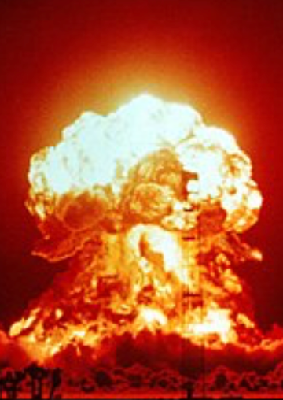
On the Edge of Nuclear Fire
The Cuban Missile Crisis
Missiles in Turkey and Cuba
Blockage
“The knot of war”
U.S. promises—and U.S. politics
Teetering: other episodes:
Mistaking moonrise
Mistaking a solar flare
Training scenarios
Colonel Petrov
KAL 006
The Vincennes
Still, by and large, something like peace
3:16
Notes:
Even more alarmingly, the world teetered on the edge of thermonuclear war during the Cuban Missile Crisis of 1962. Russian paramount leader Nikita Khrushchev was somewhat surprised by the bellicose reaction of American President John F. Kennedy to Russia’s deployment in Cuba of missiles like those the U.S. had previously deployed in Turkey next to Russia’s border. Khrushchev wrote to Kennedy: “We and you ought not now to pull on the ends of the rope in which you have tied the knot of war, because the more the two of us pull, the tighter that knot will be tied. And a moment may come when that knot will be tied so tight that even he who tied it will not have the strength to untie it, and then it will be necessary to cut that knot, and what that would mean is not for me to explain to you, because you yourself understand perfectly of what terrible forces our countries dispose…” The U.S. promised not to overthrow Cuban communist dictator Fidel Castro by force. Russia withdrew its missiles from Cuba. The U.S. withdrew its missiles from Turkey. Both agreed to keep the U.S. withdrawal a secret so as not to create a “Kennedy backed down” campaign issue that the Republicans could use against the Democrats in the 1962 and then 1964 elections. And a lot of misleading histories were written by and based on reports from Kennedy administration insiders over the following two decades.
There were other teeters. In 1960 the moonrise was mistaken by a NATO radar for a nuclear attack—and the U.S. went on high alert even though Russian paramount leader was in New York at the United Nations at the time. In 1967 NORAD thought a solar flare was Soviet radar jamming, and nearly launched its bombers. In 1979 the loading of a training scenario onto an operational computer led NORAD to call the White House, claiming that the U.S.S.R. had launched 250 missiles against the United States, and that the president had only between 3 and 7 minutes to decide whether to retaliate. In 1983 Lieutenant Colonel Stanislav Petrov refused to classify an early warning system missile sighting report as an attack, and dismissed it as an error. And in 1995 Russian President Boris Yeltsin opened his nuclear weapons control briefcase when the launch of a Norwegian northern lights-studying rocket was interpreted as an attack. In 1983 the Red Air Force mistook an off-course Korean airliner carrying 100 people for one of the U.S. RC-135 spy planes that routinely violated Russian air space to test the competence of Russia’s air defenders and shot it down; Red Air Force pilot Gennady Osipovich continues to believe he shot down a spy plane. In 1988 the U.S. Navy cruiser Vincennes—at the time in Iranian territorial waters without Iran’s permission—shot down on on-course Iranian airliner carrying 290 people.
It could have gone very badly indeed. But, compared to 1914-1945, it is only a small exaggeration to say that the world has been at peace since 1945, and continues to be at peace today.

Slide 22
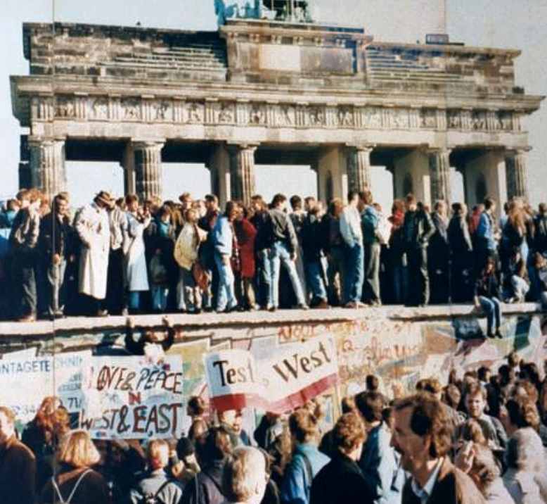
Winners of the Cold War
Khrushchev
His successors concluded that the game was up
Who made a difference?
These who kept the Cold War from getting hot
Those who persuaded others it was over
Those who worked to make the Western Alliance its beat self
My list of ten:
Harry Dexter White; George Kennan; George Marshall; Arthur Vandenberg; Paul Hoffman; Dean Acheson; Harry S Truman; Dwight D. Eisenhower; Gerald Ford; George Shultz
6:18
Notes:
In one sense, Nikita Surgeyevitch Khrushchev was a winner in the Cold War. In 1959 he wrote:
>The socialist states… ruled by the working people.... To them war spells grief and tears, death, devastation and misery. Ordinary people have no need for war.... Peaceful coexistence does not mean merely living side by side... with the constantly remaining threat of [war] breaking out in the future. Peaceful coexistence can and should develop into peaceful competition for the purpose of satisfying man's needs in the best possible way.... Let us try out in practice whose system is better, let us compete without war. This is much better than competing in who will produce more arms and who will smash whom. We stand and always will stand for such competition as will help to raise the well-being of the people to a higher level.... We may argue, we may disagree with one another. The main thing is to keep to the positions of ideological struggle, without resorting to arms in order to prove that one is right.... With military techniques what they are today, there are no inaccessible places in the world. Should a world war break out, no country will be able to shut itself off from a crushing blow.... Ultimately that system will be victorious on the globe which will offer the nations greater opportunities for improving their material and spiritual life...
Khruschchev would have been surprised that, by 1990, it was clear even to his successors sitting in the Kremlin that really-existing socialism was a dead end for humanity. But that was the conclusion people reached. The Cold War was kept from becoming hot, and ended the way Khrushchev had hoped, with one system offering clearly greater opportunities for improving material and spiritual life.
The Cold War could have ended otherwise. People could and did make a difference. Those who made the most different were, I think, those who (a) kept the Cold War from getting hot, (b) persuaded many who wanted to keep fighting it that it was over, and (c) worked hardest to make the social democratic western alliance its best self. Here is my list of the ten outside the Iron Curtain who I think did most to make it so:
Harry Dexter White: Treasury Assistant Secretary who was the major force behind the Bretton Woods Conference and the institutional reconstruction of the post-World War II world economy. He accepted enough of John Maynard Keynes's proposals to lay the groundwork for the greatest generation of economic growth the world has ever seen. It was the extraordinary prosperity set in motion by the Bretton Woods' System and institutions--the "Thirty Glorious Years"--that demonstrated that political democracy and the mixed economy could deliver and distribute economic prosperity.
George Kennan: Author of the "containment" strategy that won the Cold War. Argued--correctly--that World War III could be avoided if the Western Alliance made clear its determination to "contain" the Soviet Union and World Communism, and that the internal contradictions of the Soviet Union would lead it to evolve into something much less dangerous than Stalin's tyranny.
George Marshall: Architect of victory in World War II. Post-World War II Secretary of State who proposed the Marshall Plan, another key step in the economic and institutional reconstruction of Western Europe after World War II.
Arthur Vandenberg: Leading Republican Senator from Michigan who made foreign policy truly bipartisan for a few years. Without Vandenberg, it is doubtful that Truman, Marshall, Acheson, and company would have been able to muster enough Congressional support to do their work.
Paul Hoffman: Chief Marshall Plan administrator. The man who did the most to turn the Marshall Plan from a good idea to an effective aid program.
Dean Acheson: Principal architect of the post-World War II Western Alliance. That Britain, France, West Germany, Italy, and the United States reached broad consensus on how to wage Cold War is more due to Dean Acheson's diplomatic skill than to any single other person.
Harry S Truman: The President who decided that the U.S. had to remain engaged overseas--had to fight the Cold War--and that the proper way to fight the Cold War was to adopt Kennan's proposed policy of containment. His strategic choices were, by and large, very good ones.
Dwight D. Eisenhower: As first commander-in-chief of NATO, played an indispensable role in turning the alliance into a reality. His performance as President was less satisfactory: too many empty words about "rolling back" the Iron Curtain, too much of a willingness to try to skimp on the defense budget by adopting "massive retaliation" as a policy, too much trust in the erratic John Foster Dulles.
Gerald Ford: In the end, the thing that played the biggest role in the rise of the dissident movement behind the Iron Curtain was Gerald Ford's convincing the Soviet Union to sign the Helsinki Accords. The Soviet Union thought that it had gained worldwide recognition of Stalin's land grabs. But what it had actually done was to commit itself and its allies to at least pretending to observe norms of civil and political liberties. And as the Communist Parties of the East Bloc forgot that in the last analysis they were tyrants seated on thrones of skulls, this Helsinki commitment emboldened their opponents and their governments' failures to observe it undermined their own morale.
George Shultz: Convinced Ronald Reagan—correctly—that Mikhail Gorbachev's "perestroika" and "glasnost" were serious attempts at reform and liberalization, and needed to be taken seriously. Without Shultz, it is unlikely that Gorbachev would have met with any sort of encouragement from the United States--and unlikely that Gorbachev would have been able to remain in power long enough to make his attempts at reform irreversible.

Slide 23
The Soviet Union: An Example of “Late Development”?
If you compare the Soviet Union to non-European non-settler economies…
It does quite well—butcher’s bill aside
And it won WWII
How to reconcile these?
Neocolonial origins of comparative development?
I think not—but it is an open question
And foundations for subsequent growth laid during Stalin/Mao?
1:56
Notes:
If we assess the economy of the Soviet union in very narrow terms, considering it as a non-European non-settlement economy, it looks as though it does rather well. It moves people from the farm to the factory. It puts them to work in the factories. It builds the utility, transportation, and urban infrastructure needed to hold a modern industrial society together. Its overall level of productivity is very low. And the level of consumption it supplies to its people is vastly lower than should be generated by its industrial plant.
And it won World War II.
But there is the butcher's bill: killing people in the tens of millions is not necessary, desirable, or in any sense something that belongs on any road to economic development.
Do we think that the Soviet Union—butcher's bill aside—followed the only path that a non-European non-settler economy could follow in the middle 1900s given that the North Atlantic and the imperialist global economy had closed off other roads? I think not. For one thing, Japan shows that other roads were possible. For another, the convergence of post-WWII peripheral western Europe owes much more to good social democratic developmental institutions than to any "neocolonial" boost given to them by the United States.
If we wanted to look for silver linings, we might argue that foundations were laid under Stalin/Mao for further growth under a different system later: the mobilization of resources from a very poor economy for investment was undertaken. But I would not like to lean too heavily on that argument.

Slide 24
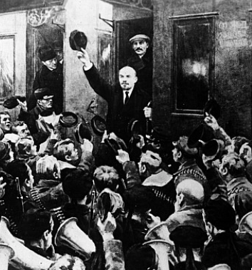
The Trajectory
Imperatives
Survive
Eliminate large-scale private property and market
Industrialize
No aid coming from Germany
War Communism
War Terror
NEP
“Scissors Crisis”
Taking Marx’s Capital not as a critique but as a business model
1:56
Notes:
Lenin did not think he had an alternative road. And some thing like Stalin's path, hopefully a lot less bloody, would have been attempted by anybody succeeding Lenin save passably Bukharin—if the regime had been able to hold together. In the absence of the expected German revolution and then large scale aid from Germany to help Russia industrialize and socialize, the regime's imperatives were three: First: to survive. Second: to eliminate large scale private property and the market economy because Marx had thought those were utterly poisonous. Third: to somehow raise the resources to industrialize quickly because no aid was coming from Germany and the regime faced mighty internal and expected soon to face substantial external enemies.
Hence war communism. Hence war terror. But those did not seem to be working, and there was the retreat to the New Economic Policy—the NEP—with its limited tolerance of the market and of the merchant entrepreneur as a useful not quite outlaw. But the NEP was always going to end in a "scissors crisis": the productive peasantry was not going to want to sell its products to the regime for kopecks, and if offered kopecks only would shift from producing grain to making higher quality meats and vegetables for their own production. The return to central planning was baked in the cake.
Marx had meant for his description of the stealing of the land from the peasantry in England and the transformation of the proletariat into agricultural and urban wage slaves as a critique. Stalin took it as a business model. Peasants were reenserfed, and in the process millions were killed and starved. And then those party cadres fearful or even insufficiently enthusiastic about Stalin's leadership—or those who had made some enemies—we're purged and killed
And so the Soviet Union's centrally planned economy was launched: a couple of hundred key commodities were controlled by material balances from the center, demands were issued to factory managers from the center, and the factory managers then had to make do—beg, borrow, barter, buy, and steal the resources over and above those directed to them by material balances in order to fulfill as much of the plan as possible. It was highly inefficient. It was highly corrupt. It did focus attention on producing those commodities on which the center placed the highest priority and to which, via material balances, it devoted the key resources.

Slide 25
Inefficiencies of Central Planning
If the Soviet Union was “European” or “recent settlement”—an absolute disaster.
If you compare the Soviet Block to the countries around its edge—an absolute disaster
Why? Because bureaucracies undisciplined by markets are really not very good at organizing production
They can—sometimes—duplicate things they can see elsewhere
They can—sometimes—generate amazing feats of resource mobilization
While sharply reducing “profiteering”
1:47
Notes:
If, however, our counterfactual is not that the Soviet Union was part of the global south but that it was, rather, a European or a recent settlement economy it was an absolute disaster. And if you look at how the Soviet model did when transplanted elsewhere, it is very hard to avoid the conclusion that it was a complete disaster and that the right counterfactual for the Soviet Union is a European one rather than a south Asian one.
When the Iron Curtain fell we could compare the Soviet bloc to the countries around its edges, in for each case the boundaries of the Soviet empire and its allies were where armies had marched during and immediately after World War II, plus Cuba. And looking across the Iron Curtain we see societies just outside five times as rich as the societies inside. You sacrificed 80% of your potential productivity, you were ruled by a tyranny, and often suffered an ungodly butchers bill of murder and famine if you found yourself on the wrong side of the Iron Curtain in the middle years of the 1900s.
Why? Because bureaucracies undisciplined by markets are really not very good at organizing production. They can sometimes duplicate things they see elsewhere. They can sometimes generate amazing efforts of resource mobilization, while sharply reducing profiteering. They can accomplish a very few narrow targets at the expense of everything else. But that is all we can expect them to do, realistically.

Slide 26
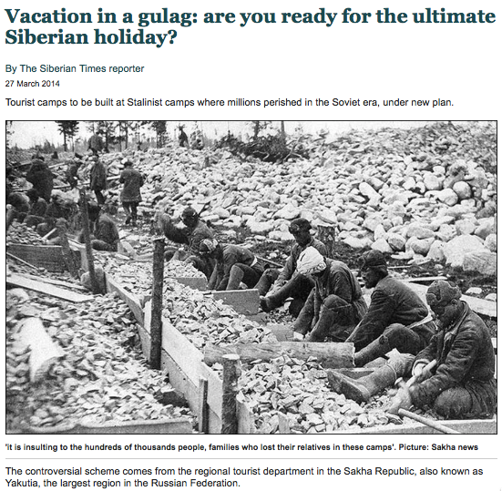
Failed Utopia: Social and Economic Organization
Max Weber: “Wherever bureaucracy gained the upper hand… it did not disappear…. State bureaucracy would rule alone if private capitalism were eliminated. The private and public bureaucracies, which now check one another to a degree, would be merged into a single hierarchy.
“This would be similar to the situation in ancient Egypt, but it would occur in a much more rational—and hence unbreakable—form… the shell of bondage which men will perhaps be forced to inhabit as powerless as the fellahs of ancient Egypt. Who would want to deny that such a potentiality lies in the womb of the future?…”
0:40
Notes:
The final judgment has to be German sociologist Max Weber's:
>Wherever bureaucracy gained the upper hand… it did not disappear…. State bureaucracy would rule alone if private capitalism were eliminated. The private and public bureaucracies, which now check one another to a degree, would be merged into a single hierarchy.
>This would be similar to the situation in ancient Egypt, but it would occur in a much more rationalized—and hence unbreakable—form… The shell of bondage which men will perhaps be forced to inhabit as powerless as the fellahs of ancient Egypt. Who would want to deny that such a potentiality lies in the womb of the future?

Slide 27
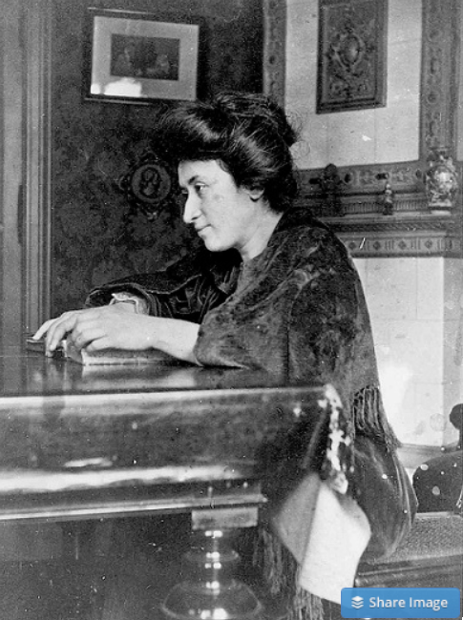
Failed Utopia: Politics
Rosa Luxemburg: “The tacit assumption underlying the Lenin-Trotsky theory of dictatorship is this: that the socialist transformation is something for which a ready-made formula lies completed in the pocket of the revolutionary party…. We [do] know more or less what we must eliminate…
“But when it comes to the nature of the thousand concrete, practical measures, large and small, necessary to introduce socialist principles into economy, law and all social relationships, there is no key in any socialist party program or textbook. That is not a shortcoming but rather the very thing that makes scientific socialism superior to the utopian varieties…”
What did Lenin do? The German war economy…
1:24
Notes:
And the final judgment has to be that of murdered German communist Rosa Luxemburg:
>The tacit assumption underlying the Lenin-Trotsky theory of dictatorship is this: that the socialist transformation is something for which a ready-made formula lies completed in the pocket of the revolutionary party…. We [do] know more or less what we must eliminate…
>But when it comes to the nature of the thousand concrete, practical measures, large and small, necessary to introduce socialist principles into economy, law and all social relationships, there is no key in any socialist party program or textbook. That is not a shortcoming but rather the very thing that makes scientific socialism superior to the utopian varieties…
That vision was 100% counter to the only way that Lenin knew to run his society: a dictatorship of the inner party because there was no proletariat mass base to serve even as a cadre for any form of open society politics, and the German war economy because Lenin had no idea of what else to do if he were going to eliminate the market.

Slide 28
Failed Utopia: Politics II
Rosa Luxemburg: “In place of… general, popular elections, Lenin and Trotsky have laid down the soviets…. Public life gradually falls asleep, a few dozen party leaders of inexhaustible energy and boundless experience direct and rule… meetings… [that] approve proposed resolutions unanimously… the dictatorship of a handful of politicians…. Such conditions must inevitably cause a brutalization of public life: attempted assassinations, shooting of hostages, etc…”
0:35
Notes:
And so, Red Rosa wrote:
>In place of… general, popular elections, Lenin and Trotsky have laid down the soviets…. Public life gradually falls asleep, a few dozen party leaders of inexhaustible energy and boundless experience direct and rule… meetings… [that] approve proposed resolutions unanimously… the dictatorship of a handful of politicians…. Such conditions must inevitably cause a brutalization of public life: attempted assassinations, shooting of hostages, etc…
She foresaw it. But she did not foresee half of it.

Slide 29
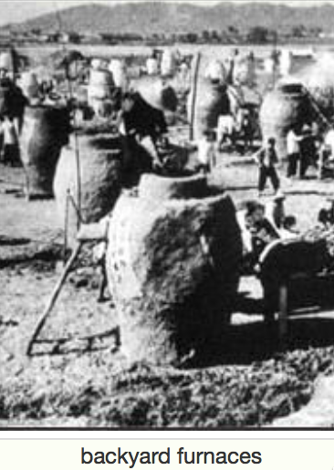
Failed Utopia: The Butcher’s Bill
Russian Civil War: 3M?
Collectivization of agriculture: 10M?
Great Terror: 2M?
Post-WWII purge: 2M?
Anti-landlordism: 4M?
Collectivization: 4M?
Great Leap Forward famine: 50M?
Cultural Revolution: 5M?
Pol Pot: 1.5M
Kim Dynasty: ????
1:24
Notes:
The butcher's bill: 3 million in the Russian Civil War. 10 million in the collectivization of agriculture. 2 million in Stalin's Great Terror against those who have been insufficiently enthusiastic about his leadership. Being a member of the inner party of the Soviet Union was the most hazardous place to be. 2 million in the post World War II purge. In China, 4 million in the anti-landlordism campaign. In China, 4 million in the collectivization of agriculture and the reenserfment of the peasantry. In China, 50 million in the famine of the Great Leap Forward: the regime took no steps to ease and in fact many steps to accentuate the famine because nobody but Peng Dehuai dared to tell Mao that there was going to be a famine. 5 million dead in the Cultural Revolution: we really do not know. Pol Pot and his Khmer Rouge got 1.5 million. And we do not know the murders of the Kim dynasty in North Korea.

Slide 30
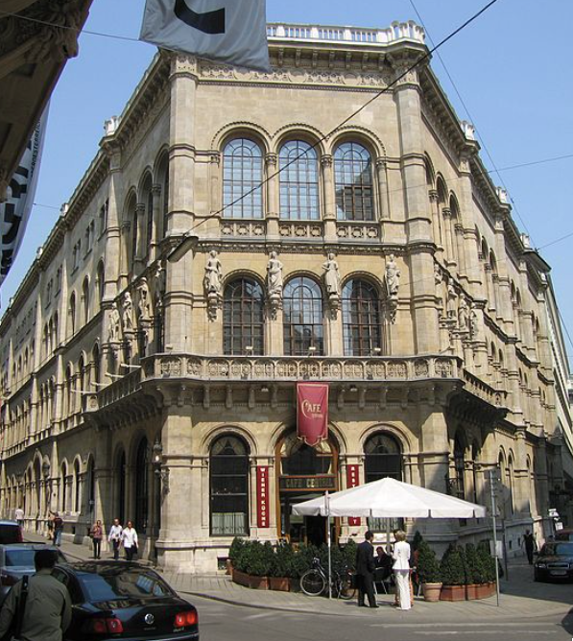
Failed Utopia: The Costs of the “Experiment”
Guenther Roth: “Weber and Schumpeter... had their famous falling-out in a Viennese coffeehouse in 1918. Weber, ‘who took nothing lightly,’ and Schumpeter, who ‘took nothing hard,’ recalled Somary who witnessed the scene, clashed over the Russian Revolution.
“Schumpeter welcomed it as a laboratory experiment…. For Weber it was going to be ‘a laboratory heaped with human corpses.’ When an enraged Weber stormed out, a smiling Schumpeter remarked: ‘How can someone carry on like that in a coffeehouse?’—the proper place for irony, never seriousness…”
0:35
Notes:
There is a strange and grim story told by sociologist Gunther Roth:
>Weber and Schumpeter... had their famous falling-out in a Viennese coffeehouse in 1918. Weber, ‘who took nothing lightly,’ and Schumpeter, who ‘took nothing hard,’ recalled Somary who witnessed the scene, clashed over the Russian Revolution. Schumpeter welcomed it as a laboratory experiment…. For Weber it was going to be ‘a laboratory heaped with human corpses.’ When an enraged Weber stormed out, a smiling Schumpeter remarked: ‘How can someone carry on like that in a coffeehouse?’—the proper place for irony, never seriousness…

Slide 31
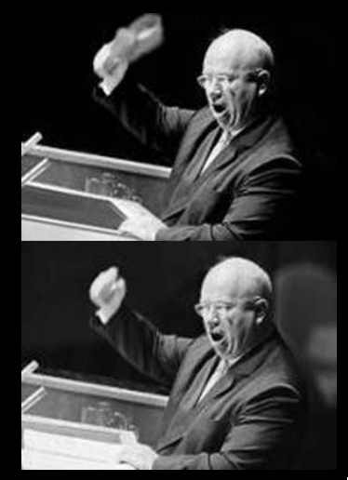
Failed Utopia: Our Friend Nikita Sergeyevitch
Francis Spufford: “So much blood, and only one justification for it…. If it had been all prologue, all only the last spasms of death in the old, cruel world…. Today the radio was reporting… Prague….
“He fumbled with the tape machine… found the RECORD key…. ‘Paradise’, he told the wheat field in baffled fury: ‘is a place where people want to end up, not a place they run from. What kind of socialism is that? What kind of shit is that, when you have to keep people in chains. What kind of social order? What kind of paradise?…’
“And then… the retired monster sat very still on the bench by the field…”
1:17
Notes:
Novelist Francis Spufford tries to enter the mind of Nikita Sergeyevitch Khrushchev, paramount leader of the Soviet Union from 1956 to 1964, in his retirement. Khrushchev was a monster, but he was a monster who believed that he was genuinely building a utopia, and that his monstrous deeds would be forgiven or were expiated or were necessary in order to build that utopia. Or so Khrushchev believed in his prime .Here is Spufford's guess at Khrushchev's thoughts in his retirement. From Francis Spufford's novel "Red Plenty":
>So much blood, and only one justification for it…. If it had been all prologue, all only the last spasms of death in the old, cruel world….
>Today the radio was reporting… Prague….
>He fumbled with the tape machine… found the RECORD key…. ‘Paradise’, he told the wheat field in baffled fury: ‘is a place where people want to end up, not a place they run from. What kind of socialism is that? What kind of shit is that, when you have to keep people in chains. What kind of social order? What kind of paradise?…’
>And then… the retired monster sat very still on the bench by the field…

Slide 32
Russia Sits Down
Successes of the Soviet Union:
By 1960, a roughly First World level of health, education, and other social indicators. However, followed by a relative decline.
The victory in World War II--and the heavy-industrial and military production that made this possible:
No market economy would ever have built a heavy industrial complex in Magnitogorsk.
And all praise to comrade Alexei Kosygin for the most extraordinary industrial relocation effort in history.
But Tukhachevsky would have done a lot better than Zhukov.
And if the Ukrainians had not had to learn to be anti-Nazi things would have gone much better.
Its relatively equal income distribution. Or was it a relatively equal income distribution?
The attainment of military-strategic parity with the United States in the 1970s. But what do you have to believe about the world to see that as an achievement rather than as a mistaken waste of resources?
2:09
Notes:
If the last years of the 1900s saw China stand up, they also saw Russia sit down.
The Soviet Union and its regime did have some things that could count as successes.
By 1960 it had a roughly 1st world level of health, education, and other social indicators. Its material poverty and its political dysfunction and tyranny were not matched by a similar degree of sociological dysfunction.
It had the victory in World War II and it had the heavy industrial and military production that made this victory possible. No market economy would have built a heavy industrial complex in Magnitogorsk. In fact no one but a paranoid madman would've built a heavy industrial complex in Magnitogorsk. Yet the heavy industrial complex in Magnitogorsk was essential in saving the world from the Nazis. And all praise to comrade Aleksey Kosygin for the most extraordinary industrial relocation effort in history in the first six months of World War II's eastern front.
But Marshall Tukhachevsky—purged by Stalin for having been too competent and too popular—would have done a lot better at commanding the armies than those able to flatter and survive under Stalin, even Zhukov.
And if the Ukrainians had not had to painfully learn that, hard as it might be to believe, being ruled by the Nazis was much worse than being ruled by even Stalin, things would've gone much much better.
The relatively equal income distribution of the Soviet Union is a plus. Or was it a relatively equal income distribution? It is hard to even think about what the real dimensions of inequality were in a society simultaneously as poor, as technologically capable, as corrupt, and as patronage network-dominated as the Soviet Union was.
The attainment of military-strategic parity with the United States in the 1970s was an accomplishment about which the Soviet Union was very very proud indeed. But what do you have to believe about the world to see that as an achievement rather than as a mistaken waste of resources?

Slide 33
Failures of the USSR
The Soviet growth rate was not impressively high when seen in a world context....
Even before 1917, the Russian economy had taken off…
The increased output achieved under the Communists was limited to steel, machinery, and military equipment.... The welfare of the working class... would have been better served by... capitalism....
The collectivization of agriculture... is a particularly vicious example....
Soviet socialism was economically irrational... driven by ideology, bureaucratic infighting, and despotic caprice… massive misallocation....
The growth slowdown after 1970 showed the ultimate weakness of socialism: while it could function in a mediocre way to build... smokestack industries... it was incapable of the sustained technological advance required for the postindustrial age...
1:23
Notes:
The failures of the Soviet Union loom much larger: The Soviet growth rate was not impressively high when seen in a world context. Even before 1917, the Russian economy had taken off. It is not at all clear that GDP was higher at any point under Soviet rule than had Lenin simply sat down and let Russia rule itself, democratically or semi-democratically. The increased output achieved under the Communists was limited to steel, machinery, and military equipment. The welfare of the working class would have been better served by capitalism.
The collectivization of agriculture is a particularly vicious example of Soviet dysfunction, terror, mass murder, and dystopia.
Soviet socialism was economically irrational: driven by ideology, bureaucratic infighting, and despotic caprice, with massive misallocations. The growth slowdown after 1970 showed the ultimate weakness of socialism: It could function in a mediocre way to build smokestack industries. But it was incapable of the sustained technological advance required for the postindustrial age, or indeed to deliver a high level of material well being to its subjects in the industrial age.

Slide 34
Robert Allen’s Case
Robert Allen:
“[In Britain] private property and… representative government... was the basis of civil society independent of the state.... [In Russia] the "rule of law" was a tool by which the tsar and nobles exploited the peasants rather than an impartial umpire…. Tsarist Russia [thus] lacked the social, legal and economic institutions that theorists of economic growth have argued are prerequisites for capitalist development. Indeed, much of the rest of the world lacked--and still lacks--this as well....
“Two responses are possible... create the missing prerequisites... create substitutes.... Russia's path to industrial society was based on the state's creating policies and institutions to substitute.... In the absence of the communist revolution and the Five-Year Plans, Russia would have remained as backward as much of Latin America or, indeed, South Asia. That fate was avoided by Stalin's economic institutions…”
Resource mobilization is not productivity-frontier post-industrial market capitalist development. But it is resource mobilization
1:32
Notes:
The brilliant economic historian Robert Allen tries to make the case for the Soviet Union's economy. It is not clear to me why. It seems to me he just gets hypnotized by the challenge of making the argument. Robert Allen:
>[In Britain] private property and… representative government... was the basis of civil society independent of the state.... [In Russia] the "rule of law" was a tool by which the tsar and nobles exploited the peasants rather than an impartial umpire…. Tsarist Russia [thus] lacked the social, legal and economic institutions that theorists of economic growth have argued are prerequisites for capitalist development. Indeed, much of the rest of the world lacked—and still lacks—this as well....
>Two responses are possible... create the missing prerequisites... create substitutes.... Russia's path to industrial society was based on the state's creating policies and institutions to substitute.... In the absence of the communist revolution and the Five-Year Plans, Russia would have remained as backward as much of Latin America or, indeed, South Asia. That fate was avoided by Stalin's economic institutions…
In short, resource mobilization is not productivity-frontier post-industrial market capitalist development. But it is resource mobilization. And resource mobilization is something. Many colonized and post-colonial societies failed even to accomplish resource mobilization. The Soviet Union succeeded in doing so.

Slide 35
Robert Allen’s Case II
Robert Allen:
Pre-October Revolution growth "a one-off resource boom with a veneer of some tariff-induced industrialization.” Russia was headed for a Latin American or South Asian destiny.
You needed a Big Push, and heavy industry was the Turnpike.
Planning could coordinate a Big Push to replicate the industrial structure you know you want to have.
Russia was saved from India's fate by a rapid demographic transition fueled primarily by the large scale emancipation of women.
Rapid industrialization driven by resource mobilization.
A post-Stalin slowdown was due to (a) the requirements of military spending and (b) "hare-brained schemes”.
But those were baked into the system, right? You cannot take the system’s successes and ignore its failures.
2:29
Notes:
To summarize Bob Allen's argument:
• Pre-October Revolution growth "a one-off resource boom with a veneer of some tariff-induced industrialization.” Russia was headed for a Latin American or South Asian destiny.
• You needed a Big Push, and heavy industry was the Turnpike.
• Planning could coordinate a Big Push to replicate the industrial structure you know you want to have.
• Russia was saved from India's fate by a rapid demographic transition fueled primarily by the large scale emancipation of women.
• Rapid industrialization driven by resource mobilization.
• A post-Stalin slowdown was due to (a) the requirements of military spending and (b) "hare-brained schemes”.
But those were baked into the system, right? You cannot take the system’s successes and ignore its failures. I simply do not find Allen convincing here.

Slide 36
Market Organization Matters a Lot
We have covered this enormously…
The lesson I draw from this tale is that—in contrast to, say, Soviet Georgia and Kazakhstan—Ukraine and Russia (and much more so Lithuania, Latvia, Estonia, and Leningrad Oblast) should have looked like western Europe: Finland and Sweden at best, Italy and Spain at worst, when the Iron Curtain fell if the Soviet economy had been a “success:
Rick Ericson:
“Prices… used for measurement, accounting, and control purposes”: i.e., not for incentives.
“Prices provide irrelevant or incorrect information about relative values and scarcities”.
“The traditional Soviet economic system is very good at mobilizing scarce resources and concentrating on a few clear, well-defined objectives that can be expressed in measurable, quantitative, and communicable terms, and that yield large observable changes as outcomes…”
1:15
Notes:
The bottom-line lesson I draw from this tale is that—in contrast to, say, Soviet Georgia and Kazakhstan—Ukraine and Russia (and much more so Lithuania, Latvia, Estonia, and Leningrad Oblast) should have looked like western Europe: Finland and Sweden at best, Italy and Spain at worst, when the Iron Curtain fell if the Soviet economy had been a “success:
I quote my teacher Rick Ericson:
• “Prices… used for measurement, accounting, and control purposes”: i.e., not for incentives.
• “Prices provide irrelevant or incorrect information about relative values and scarcities”.
• “The traditional Soviet economic system is very good at mobilizing scarce resources and concentrating on a few clear, well-defined objectives that can be expressed in measurable, quantitative, and communicable terms, and that yield large observable changes as outcomes…”

Slide 37
“Peaceful Competition”
N.S. Khrushchev (1958):
“Must we, in this period of the flourishing of human genius which is penetrating the secrets of nature and harnessing its mighty forces, put up with the preservation of relations that existed between people when man was still a beast?…
“Time is a good adviser, or as the Russian people say, ‘Take counsel of one's pillow’. This is a wise saying…. We shall do everything we can to tilt the barometer's hand away from ‘Storm’ and even from ‘Changeable’ to show ‘Fine.’
“I am confident, comrades, that… when the socialist camp has some one billion people and tremendous productive potential, when the Soviet Union has reached great heights in industry and agriculture, science, technology and culture, we can do a lot for the sake of peace.
“In our actions we rely on reason, on truth, on the support of all the people. Moreover, we rely on our great potential. And let it be known to those who want to continue the cold war so as to turn it sooner or later into a shooting war, that in our time only a madman can start a war and he himself will perish in its flames…”
Russia and its empire’s destinies after the 1989 fall of the Iron Curtain we will leave to later in the course…
1:25
Notes:
But I prefer to end this on a positive note. Let me quote the monster N.S. Khrushchev, paramount leader of the Soviet Union from 1956 to 1964, at his best, back in 1958:
>Must we, in this period of the flourishing of human genius which is penetrating the secrets of nature and harnessing its mighty forces, put up with the preservation of relations that existed between people when man was still a beast?…
>Time is a good adviser, or as the Russian people say, ‘Take counsel of one's pillow’. This is a wise saying…. We shall do everything we can to tilt the barometer's hand away from ‘Storm’ and even from ‘Changeable’ to show ‘Fine.’
>I am confident, comrades, that… when the socialist camp has some one billion people and tremendous productive potential, when the Soviet Union has reached great heights in industry and agriculture, science, technology and culture, we can do a lot for the sake of peace.
>In our actions we rely on reason, on truth, on the support of all the people. Moreover, we rely on our great potential. And let it be known to those who want to continue the cold war so as to turn it sooner or later into a shooting war, that in our time only a madman can start a war and he himself will perish in its flames…
Russia and its empire’s destinies after the 1989 fall of the Iron Curtain we will leave to later in the course…

Slide 38
Takeaways from This Time
The Cold War: Lecture & Ch 15
Give me five takeaways from this lecture…

Slide 39
Notes: What Was Unconvincing Today?
Mistakes and unclarities: typos, wordos, and mindos…
In the DRAFT textbook?
In the lecture?

Slide 40
Catch Our Breath…
Ask a couple of questions?
Make a couple of comments?
Any more readings to recommend?

Slide 41
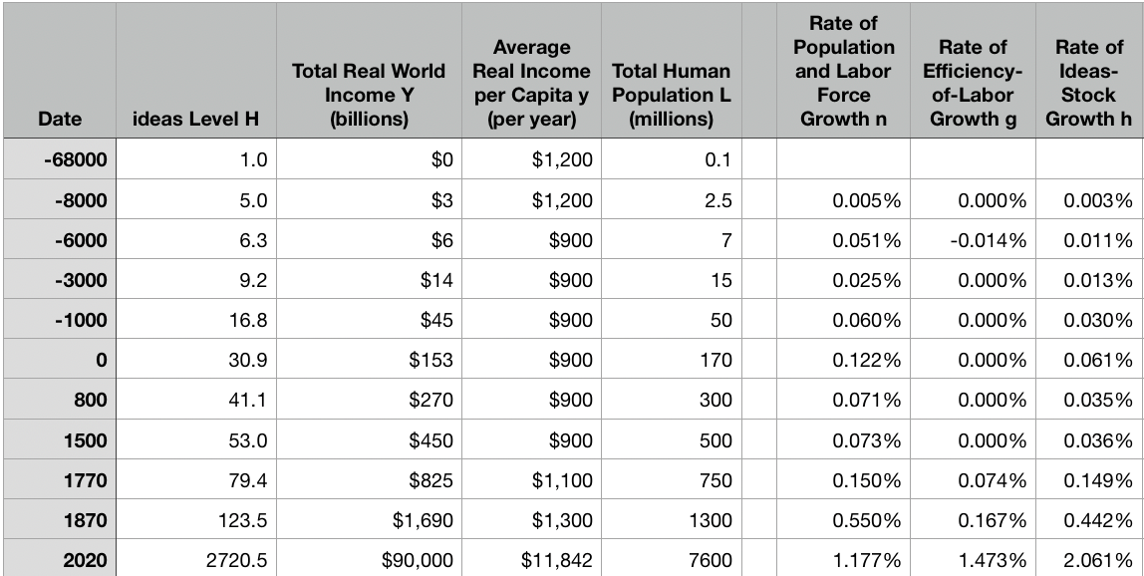
Reviews
Post-1870 is the miracle:

Slide 42
Review: The Broad Sweep
Post-1870 is the miracle:

Slide 43
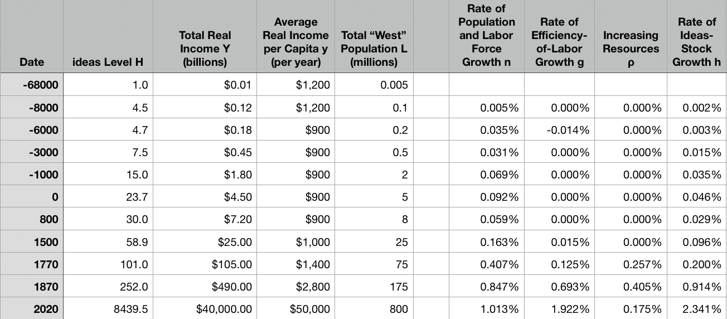
“The West”
800, 1500, 1770, or 1870?:

Slide 44
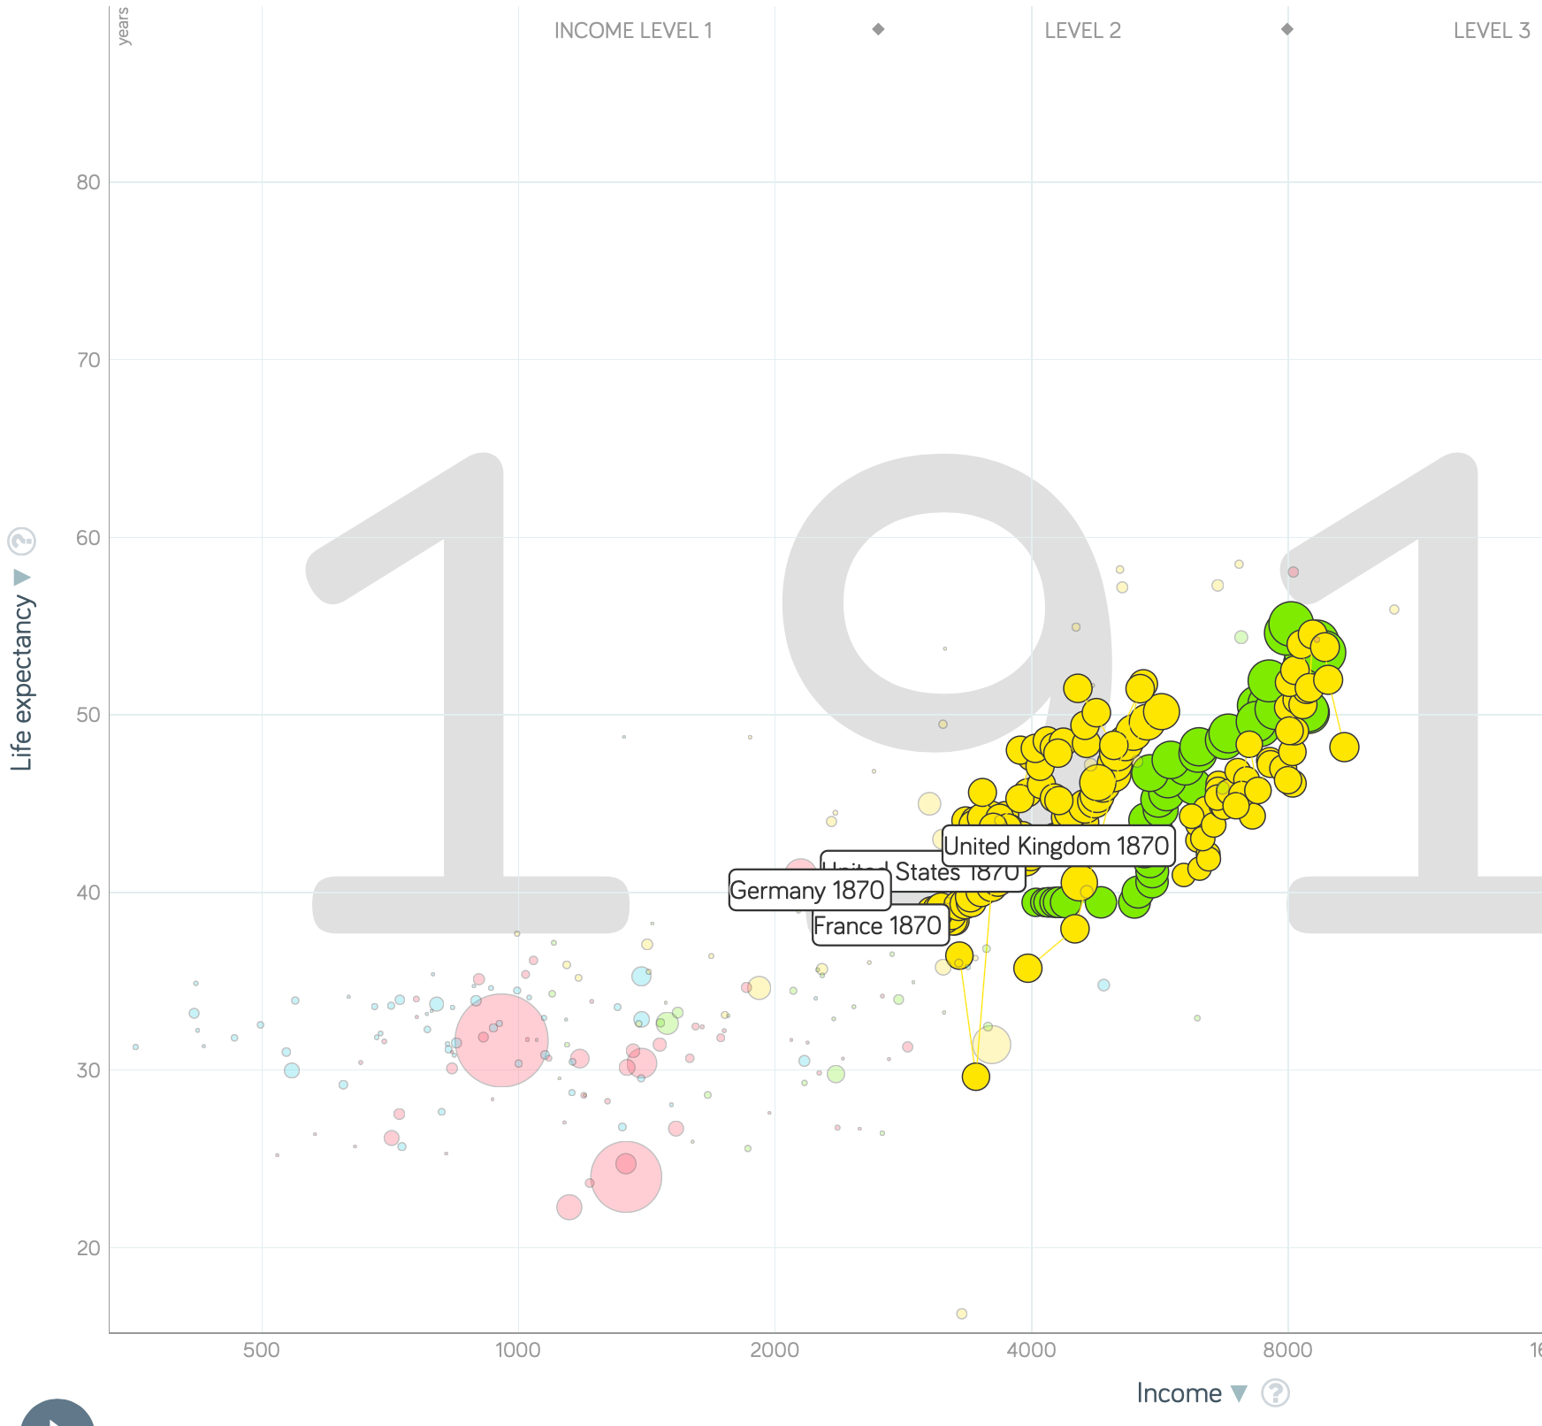
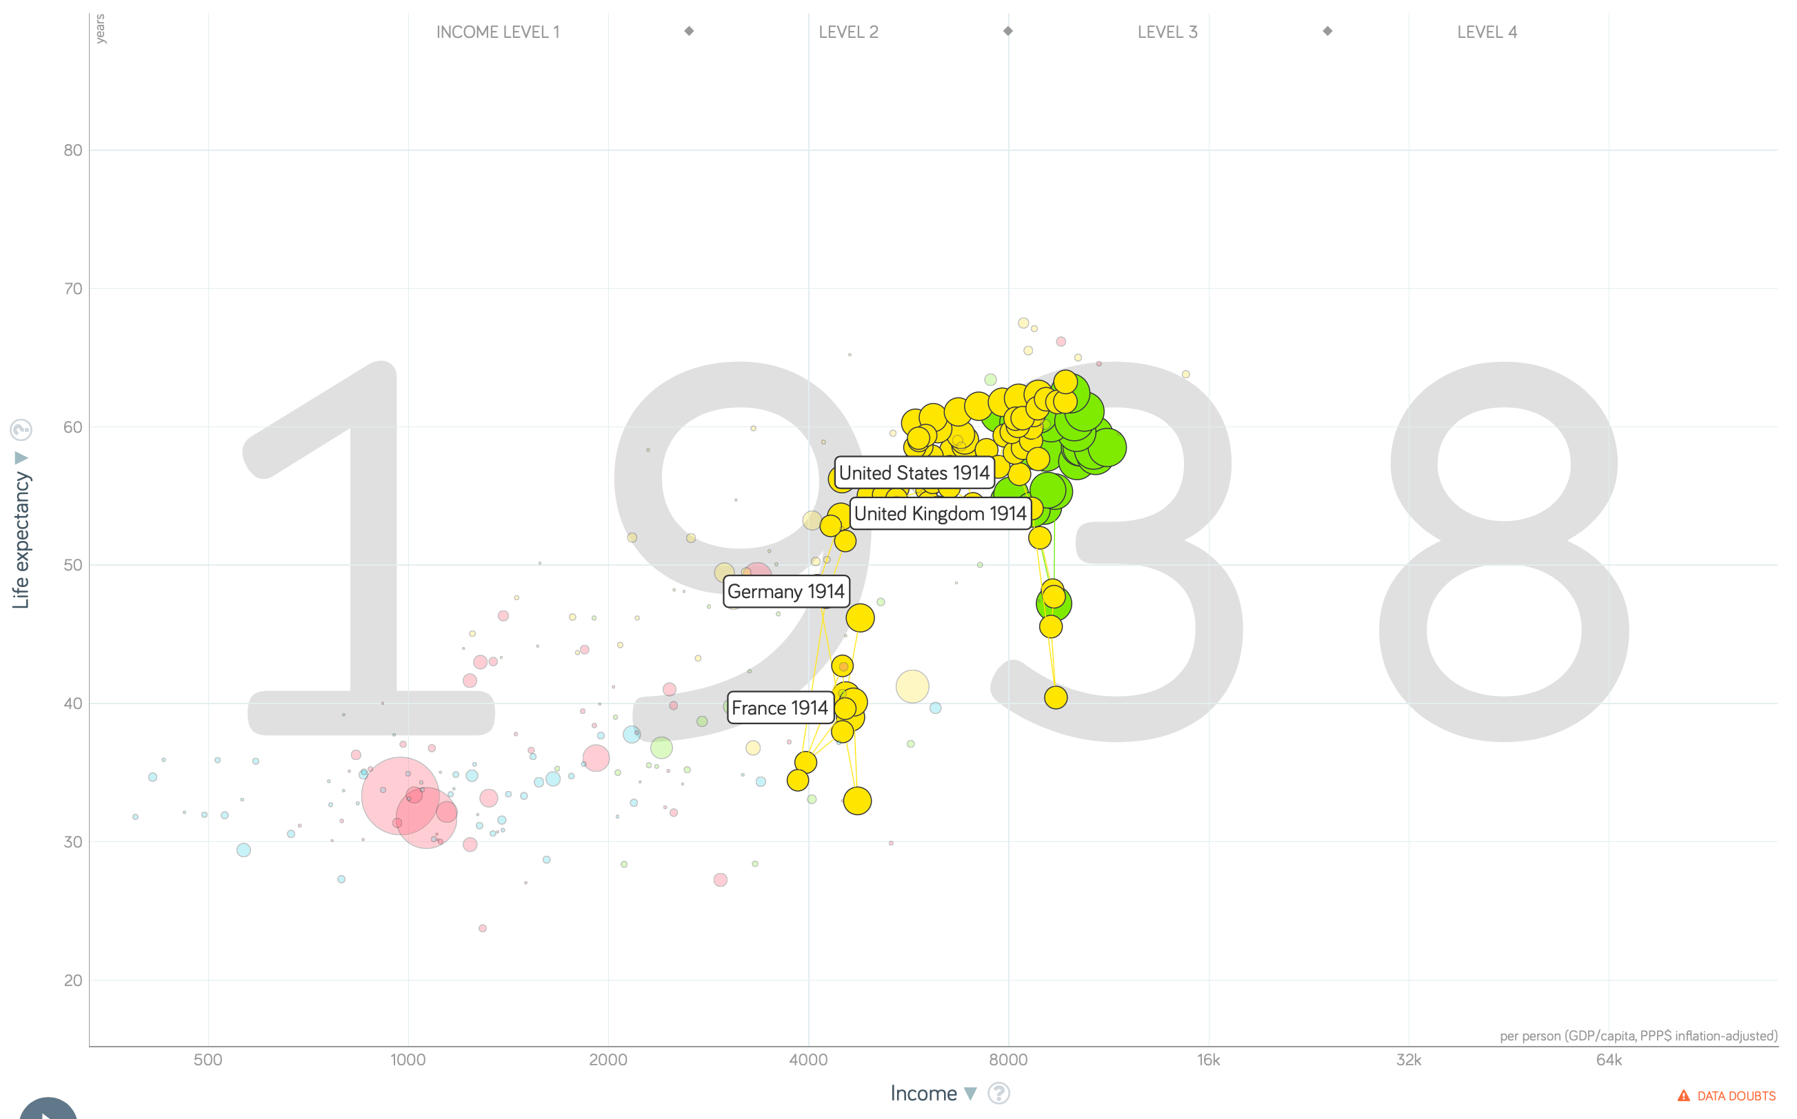
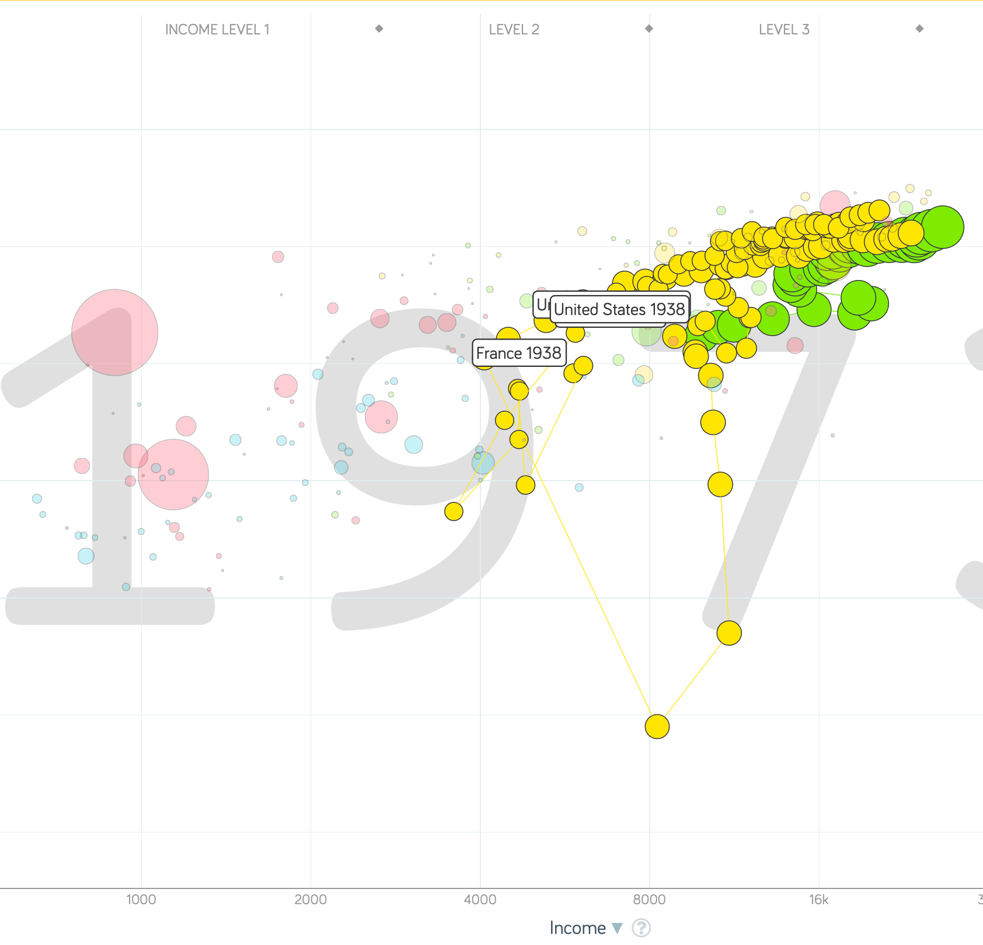
“The West”
1914-1938, 1870-1913, & 1938-1973
Rate of growth in the North Atlantic industrial core halves comparing 1870-1913 to 1914-1938; then triples afterwards over 1938-1973
Slows again after 1973

Slide 45
To Your iClickers
What was the growth rate of ideas in the industrial core of the world economy over 1870-2020?
About 2.3%/year
About 0.9%/year
About 0.23%/year
About 4%/year
None of the above

Slide 46
To Your iClickers
What was the growth rate of ideas in the industrial core of the world economy over 1770-1870?
About 2.3%/year
About 0.9%/year
About 0.23%/year
About 4%/year
None of the above

Slide 47
Review: The Belle Époque Broken
John Maynard Keynes:
“Very few of us realise[d] with conviction the intensely unusual, unstable, complicated, unreliable, temporary nature of the economic organisation by which Western Europe has lived for the last half century. We assume some of the most peculiar and temporary of our late advantages as natural, permanent, and to be depended on, and we lay our plans accordingly.
“On this sandy and false foundation we scheme for social improvement and dress our political platforms, pursue our animosities and particular ambitions, and feel ourselves with enough margin in hand to foster, not assuage, civil conflict in the European family....
“France, Germany, Italy, Austria, and Holland, Russia and Roumania and Poland, throb together, and their structure and civilisation are essentially one. They flourished together, they have rocked together in a war which we, in spite of our enormous contributions and sacrifices (like though in a less degree than America), economically stood outside, and they may fall together…”

Slide 48
Aristocracy & Social Democracy
The aristocrats had rolled the dice:
Europe in 1914 was a Europe of national populations, of industrialists and socialists, of factory workers and technicians…
Europe’s governments in 1914—especially the defense and foreign affairs ministries—had been populated by aristocrats, ex-aristocrats, and would-be aristocrats.
Landed, aristocratic, military elites had control of many of the levers of propaganda and power…
Aristocrats had had help. Industrialists and entrepreneurs were eager to provide their political support in return for economic benefits, as in the 1879 German “marriage of iron and rye”: the imposition of tariffs on imports of British steel (to protect the positions of German manufacturers) and on imports of American grain (to protect the positions of German landlords)…
On the eve of World War I, these landed military service aristocrats, ex-aristocrats, and would-be aristocrats increasingly found themselves members of a social caste that had no societal function…
But power—in the form of office and of vast (if declining relative) wealth—and propaganda—in the form of pageantry and the press—were reinforced by ideologies: Social darwinism…
The aristocrats rolled the dice—and lost…
Social democrats picked up the chips:
Expanded suffrage…
Proportional representation…
“Lands fit for heroes…”
How to provide for the benefits politicians promised?

Slide 49
Reparations, Taxes, and Inflation
Reparations
A peace “without annexations and indemnities”…
But not without reparations…
Two years’ of Germany’s national income demanded:
Much of it “boob bait for the bubbas…” on the part of Allied politicians…
But a powerful shaper of post-WWI Germany
Taxes
High and progressive tax rates…
A powerful impact on inequality…
Class war…
Inflation
U.S.: price level x1.5
Britain: price level x2.0
France: price level x7.0
French government had encouraged investment in Russian bonds…
German: price level x1,000,000,000,000
Austria, Hungary, Czechoslovakia the same…

Slide 50
Keynes’s Protest
Jan Christian Smuts:
“Poor Keynes often sits with me at night after a good dinner and we rail against the world and the coming flood. And I tell him that this is the time for Grigua’s prayer (the Lord to come himself and not to send his Son, as this is not a time for children). And then we laugh, and behind the laughter is [Herbert] Hoover’s horrible picture of thirty million people who must die unless there is some great intervention. But then again we think that things are never really as bad as that; and something will turn up, and the worst will never be. And somehow all these phases of feeling are true and right in some sense…”

Slide 51
Keynes’s Protest II
John Maynard Keynes:
“If we aim deliberately at the impoverishment of Central Europe, vengeance, I dare predict, will not limp. Nothing can then delay for long that final civil war between the forces of reaction and the despairing convulsions of revolution, before which the horrors of the late German war will fade into nothing, and which will destroy... the civilization and progress of our generation…”

Slide 52
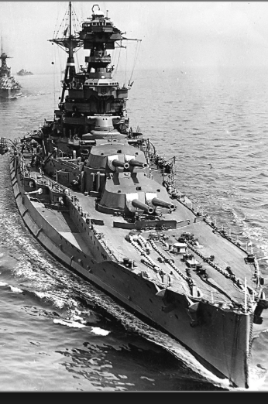
Review: World War I
Nationalism
Max Weber: “The vulgar conception of political economy is that it consists in working out recipes for making the world happy.… However… elbow-room… can [only] be won… through the hard struggle.... That standard of value adopted by a German economic theorist, can… be nothing other than a German policy and a German standard.... Our successors will... hold us responsible... for the amount of elbow-room we conquer.... The science of political economy is... a servant of... the lasting political-power interests of... our nation's power, and the vehicle of that power, the German national state…”
Erich von Manstein: von Manstein, von Lewinsky, Lewinski, Levi…
“We offered 4 battleships a year, the navy demanded 6, and we compromised at 8”

Slide 53
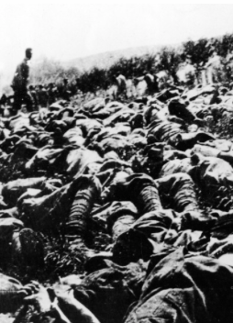
The Catastrophe of World War I: Origins
In the summer of 1914 the empires of Russia and Austria-Hungary are skirmishing diplomatically and threatening each other militarily about the latest Balkan crisis
Began when in the summer of 1914 the Archduke Franz Ferdinand and his wife Sophie were assassinated in Sarajevo
By terrorists with very close links to the intelligence service of the Kingdom of Serbia
What would Austria’s response be?
And then Germany attacks Belgium
And then Australia attacks Turkey

Slide 54
The Catastrophe of World War I: Causes
Why?: “If there is a war, let it come now…”
Russia thought it would have to fight Germany someday, and might as well while France was interested…
Austria, France, Britain (as a result of the German battle fleet) the same
“Busy giddy minds with foreign quarrels…”
A wiser man: Otto von Bismarck:
“There is nothing in the Balkans worth the bones of a single Pomeranian grenadier…”

Slide 55
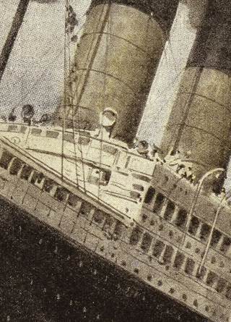
How Does the U.S. Get Involved?
British policy: binding the U.S. upper class to Britain since the 1840s
The Law of the Sea
Neutrals
Blockade
The submarine
Unrestricted submarine warfare
Zimmerman Telegram
Woodrow Wilson
“Teach the Mexicans to elect good men…”
“The war to end war…”

Slide 56
The Catastrophe of World War I: Outcome—Human
Combatants had mobilized 65M out of 100M men of military age
10M killed
10M maimed
Civilian casualties less than 10% of military
Costs of 1.5x a year’s GDP
Plus a 15M global flu epidemic
Russian, Austro-Hungarian, German, Ottoman Turkish Empires all gone…
Representative governments destabilized—or weak…
The Russian Revolution…
Hungarian, Bavarian socialist republics (short-lived)
Spartakist…
Allies demand 2 years of German GDP as “reparations”…

Slide 57
Catch Our Breath…
Comments?
Questions?

Slide 58
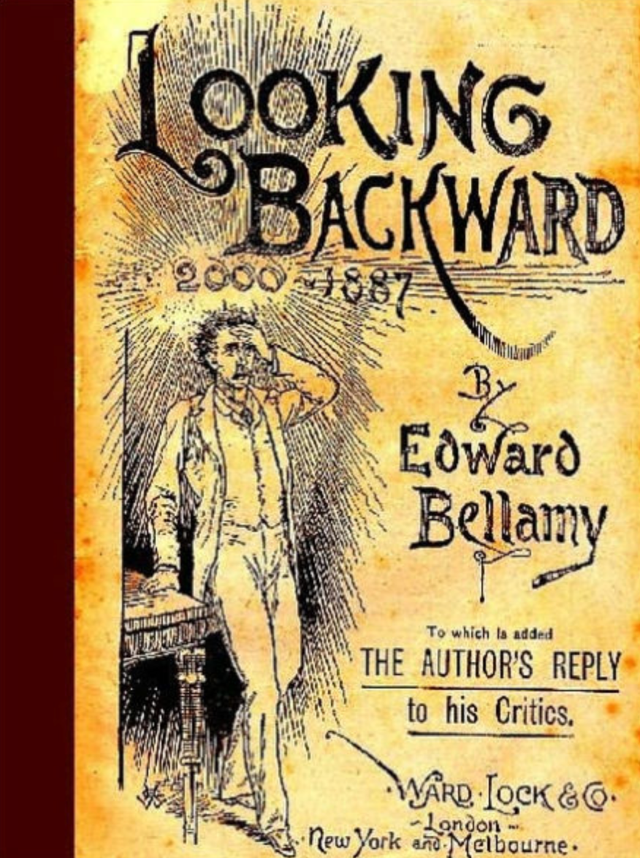
Review: Edward Bellamy: Looking Backward
Edward Bellamy: Looking Backward <https://delong.typepad.com/files/bellamy-backward.pdf>: Perhaps the third best-selling novel of the 19th century in the United States
2000 is a utopia…
The narrator is carried forward in time from 1887-2000 by an implausible plot device:
‘“This is the tenth day of September in the year 2000, and you have slept exactly one hundred and thirteen years, three months, and eleven days…”’
He then wanders around, looking at the utopia of 2000…
The opening:
‘“How could I live without service to the world?” you ask…. The answer is that my great-grandfather had accumulated a sum of money on which his descendants had ever since…. The sum had been originally by no means large. It was, in fact, much larger now that three generations had been supported upon it in idleness, than it was at first…’

Slide 59
The Stagecoach of Society
Those who ride and this who pull:
‘Commiseration was frequently expressed by those who rode for those who had to pull the coach, especially when the vehicle came to a bad place in the road, as it was constantly doing, or to a particularly steep hill. At such times, the desperate straining of the team, their agonized leaping and plunging under the pitiless lashing of hunger, the many who fainted at the rope and were trampled in the mire, made a very distressing spectacle, which often called forth highly creditable displays of feeling on the top of the coach.
‘At such times the passengers would call down encouragingly to the toilers of the rope, exhorting them to patience, and holding out hopes of possible compensation in another world for the hardness of their lot, while others contributed to buy salves and liniments for the crippled and injured. It was agreed that it was a great pity that the coach should be so hard to pull, and there was a sense of general relief when the specially bad piece of road was gotten over. This relief was not, indeed, wholly on account of the team, for there was always some danger at these bad places of a general overturn in which all would lose their seats.
‘It must in truth be admitted that the main effect of the spectacle of the misery of the toilers at the rope was to enhance the passengers’ sense of the value of their seats upon the coach, and to cause them to hold on to them more desperately than before…

Slide 60
The Stagecoach of Society II
“Finer clay”:
‘The other fact is yet more curious, consisting in a singular hallucination which those on the top of the coach generally shared, that they were not exactly like their brothers and sisters who pulled at the rope, but of finer clay, in some way belonging to a higher order of beings who might justly expect to be drawn. This seems unaccountable, but, as I once rode on this very coach and shared that very hallucination, I ought to be believed.
‘The strangest thing about the hallucination was that those who had but just climbed up from the ground, before they had outgrown the marks of the rope upon their hands, began to fall under its influence. As for those whose parents and grand-parents before them had been so fortunate as to keep their seats on the top, the conviction they cherished of the essential difference between their sort of humanity and the common article was absolute. The effect of such a delusion in moderating fellow feeling for the sufferings of the mass of men into a distant and philosophical compassion is obvious.
‘To it I refer as the only extenuation I can offer for the indifference which, at the period I write of, marked my own attitude toward the misery of my brothers…

Slide 61
The Stagecoach of Society III
Class war:
‘The sanguine argued very forcibly that it was in the very nature of things impossible that the new hopes of the workingmen could be satisfied, simply because the world had not the wherewithal to satisfy them. It was only because the masses worked very hard and lived on short commons that the race did not starve outright, and no considerable improvement in their condition was possible while the world, as a whole, remained so poor.
‘It was not the capitalists whom the laboring men were contending with, these maintained, but the iron-bound environment of humanity, and it was merely a question of the thickness of their skulls when they would discover the fact and make up their minds to endure what they could not cure.
The less sanguine admitted all this. Of course the workingmen’s aspirations were impossible of fulfillment for natural reasons, but there were grounds to fear that they would not discover this fact until they had made a sad mess of society. They had the votes and the power to do so if they pleased, and their leaders meant they should. Some of these desponding observers went so far as to predict an impending social cataclysm. Humanity, they argued, having climbed to the top round of the ladder of civilization, was about to take a header into chaos…’

Slide 62
The Limit of Human Felicity I
In the music room:
‘She made me sit down comfortably, and, crossing the room, so far as I could see, merely touched one or two screws, and at once the room was filled with the music of a grand organ anthem; filled, not flooded, for, by some means, the volume of melody had been per- fectly graduated to the size of the apartment. I listened, scarcely breathing, to the close. Such music, so perfectly rendered, I had never expected to hear.
‘“Grand!” I cried, as the last great wave of sound broke and ebbed away into silence. “Bach must be at the keys of that organ; but where is the organ?”…
‘“There are a number of music rooms in the city, perfectly adapted acoustically to the different sorts of music. These halls are connected by telephone with all the houses of the city…. Any one of the four pieces now going on that you prefer, you can hear by merely pressing the button which will connect your house-wire with the hall where it is being rendered…”’

Slide 63
The Limit of Human Felicity III
Four live orchestras you can listen to on the speakerphone!
‘“It appears to me, Miss Leete,” I said, “that if we could have devised an arrangement for providing everybody with music in their homes, perfect in quality, unlimited in quantity, suited to every mood, and beginning and ceasing at will, we should have considered the limit of human felicity already attained, and ceased to strive for further improvements…”’

Slide 64
Review: The View from 3000: Themes & Big Ideas
Science reaches critical mass and from it springs engineering—all of the engineering subdisciplines, including the management of human resources and of organizations. From a liberal political order spring national and then the global market economy. And from engineering and the market, and the large bureaucratic corporation then, over the course of 1870-2016, spring…
History was economic…
Explosion of wealth…
Cornucopia of technology…
Demographic transition…
Feminist revolution…
Inclusion and hierarchy attenuation…
Empowered tyrannies…
Wealth gulfs…
Mismanagement and insecurity…

Slide 65
Measuring Growth
What are my estimates of the rate of growth of economically-useful human knowledge over 1-1500, 1500-1800, 1800-1870, and 1870-2000?
0.02%/year, 0.2%/year, 0.5%/year, and 0.8%/year
0.000%/year, 0.02%/year, 0.2%/year, and 0.8%/year
0.02%/year, 0.2%/year, 0.8%/year, and 2.3%/year
0.2%/year, 0.8%/year, 2.3%/year, and 4.7%/year
None of the above.

Slide 66
What Is the Key Factor in the Explosion of Wealth in the 20th Century?
Yes, many things contributed. But suppose you have to pick just one

Slide 67
What Are the Four Factors That I See as Making for the Explosion of Wealth in the 20th Century?
Yes, there are many, many more things that contributed. But suppose you have to pick just four:

Slide 68
Demography II
What is the principal cause of the demographic transition?
Female wealth and control of property.
Female literacy.
Falling infant and child mortality.
Land shortages and high unemployment.
Something else.

Slide 69
Feminism
How many pregnancies do we think Abigail Smith Adams had between when she was 20 and 34?
2.
4.
6.
8.
18.

Slide 70
Empowered Tyrannies II
How many world leaders are members of the 10-million club?
2.
4.
6.
8.
18.

Slide 71
Inclusion and Hierarchy Attenuation
At the start of the 1970s, future President Ronald Reagan said that diplomats from Tanzania appeared uncomfortable:
resisting pressure to vote with the Soviet Union at the United Nations.
making small talk with New York socialites.
wearing shoes.
in formal tuxedos.
None of the above.

Slide 72
Economic Mismanagement and Insecurity II
According to Karl Polanyi, what rights does the market economy respect?
rights to land (a stable community).
rights to labor (a “just” income).
rights to finance (a stable economic place).
rights to property (the ability to keep what you manage to claim to earn).
None of the above.

Slide 73
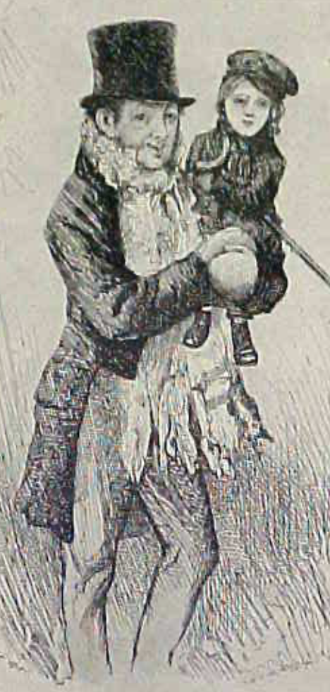
Review: The Watershed: 1870 as an Inflection Point
As of 1870, had the Industrial Revolution raised the standard of living or lightened the toil of the working class in England, the country at its center?
Yes
No
It’s not clear
Why? Malthusian forces—population explosion & thus smaller farm sizes. Growth, the growth had been slow 0.8%/year?

Slide 74
Globalization
Who called the era of globalization and growth from 1870 to 1914 an “economic El Dorado”?
Karl Marx
John Stuart Mill
Thomas Robert Malthus
John Maynard Keynes
None of the above
What would the others have said?

Slide 75
Migration
How many people of the roughly 1.5 billion then-population of the world left their continents of origin between 1870-1913?
10 million
50 million
100 million
200 million
400 million

Slide 76
Before 1870, Ideas Growth Not Fast Enough
And population growth accelerates as the world is not rich enough to undergo the demographic transition:
Value of useful and deployed ideas about technology and organization
-8000: 1
1: 3.5
1500: 4.75
1800: 9
1870: 16
2020: 421
Growth Rates:
-8000 to 1500: 0.02%/year
1500 to 1800: 0.2%/year
1800 to 1870: 0.8%/year
1870 to 2020: 2.3%/year
What caused these accelerations? What caused this last acceleration?

Slide 77
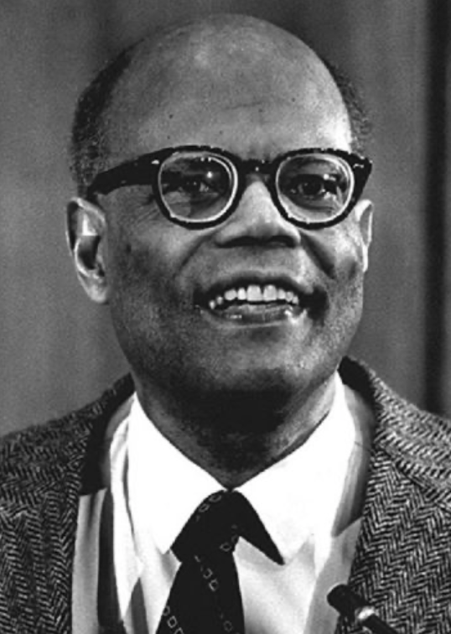
The Last Acceleration
The industrial research lab to routinize invention, and the modern corporation to routinize diffusion and deployment
Plus general purpose technologies—machine tools, non-human power sources
Arthur Lewis:
“New commodities: telephones, gramophones, typewriters, cameras, automobiles, and so on, a seemingly endless process whose latest twentieth-century additions include aeroplanes, radios, refrigerators, washing machines, television sets, and pleasure boats. Thus a rich man in 1870 did not possess anything that a rich man of 1770 had not possessed; he might have more or larger houses, more clothes, more pictures, more horses and carriages, or more furniture than say a school teacher possessed, but as likely as not his riches were displayed in the number of servants whom he employed rather than in his personal use of commodities…”
Not so much the particular technologies, as the grasping of the fact that there was a broad and deep range of new technologies to be discovered.
As much as it was new technologies, it was large-scale corporate organizations that could and did plan the division of labor to make use of and then market technologies.
And as much, it was that the global market meant that there was now a great deal of money to be made from the routinization of the exploration, development, and deployment of technological possibilities

Slide 78
Worldwide: The Broad Sweep
Post-1870 is the miracle:

Slide 79
“The West”
800, 1500, 1770, or 1870?:

Slide 80
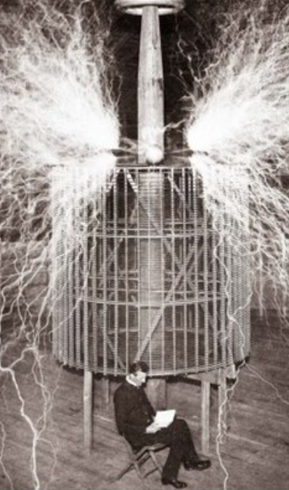
Who Is This Man?
And is he in any real danger?
Thomas Edison, and no
Andrew Carnegie, and no
Nicola Tesla, and no
Thomas Edison, and yes
Herbert Hoover, and yes

Slide 81
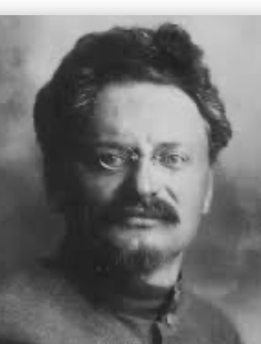
Lev Bronstein
Why did he say this?
“I had had no time to more than catch the general life-rhythm of the monster known as New York…”
“I left for Europe with the feeling of a man who has had only a peek into the furnace where the future is being forged…"

Slide 82
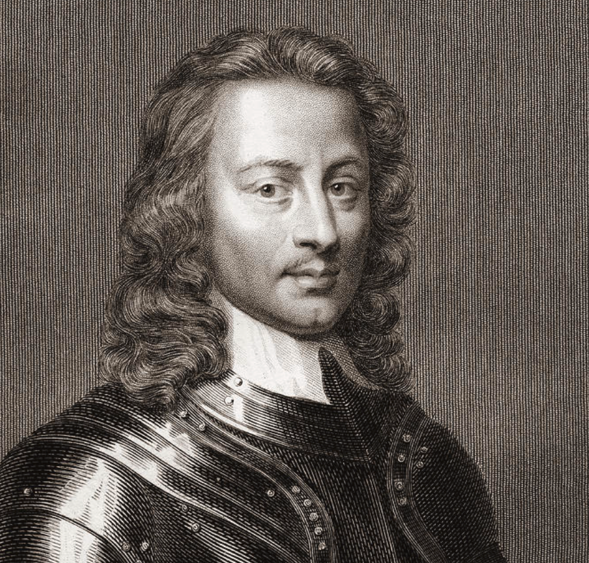
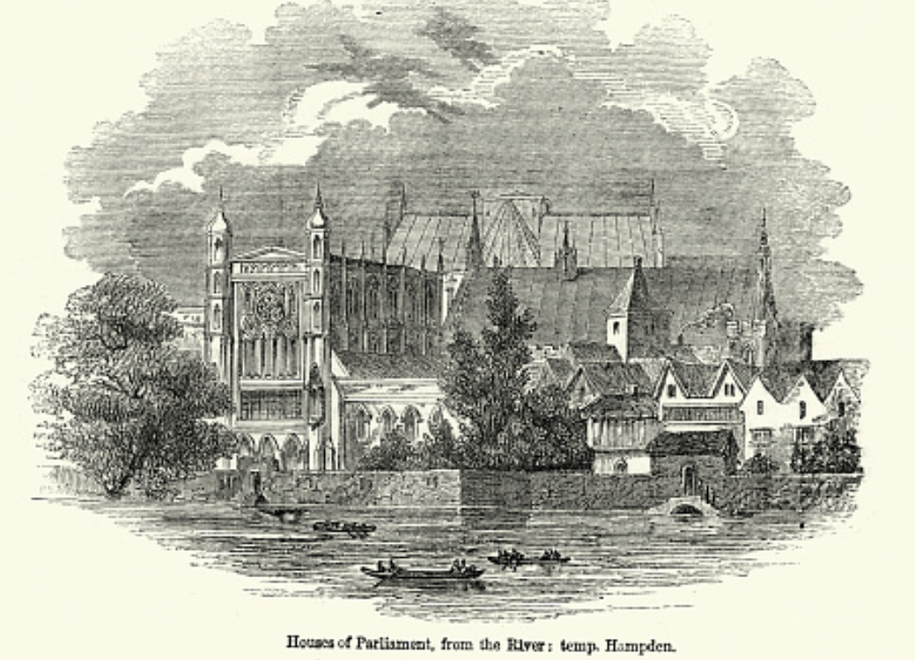
Review: Political Economy
From “Divine Right” and “Natural Order” to Enlightenment values…
Who was the first person to draft these words:?
“We hold these truths to be sacred & undeniable:
that all men are created equal & independant,
that from that equal creation they derive rights inherent & inalienable,
among which are the preservation of life, & liberty, & the pursuit of happiness;
that to secure these ends, governments are instituted among men, deriving their just powers from the consent of the governed…”
John Locke
Niccolo Machiavelli
Thomas Hobbes
Thomas Jefferson
George Washington
Why did he write them?

Slide 83
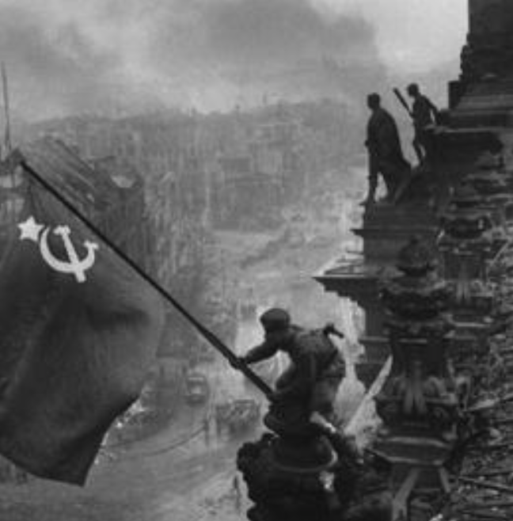
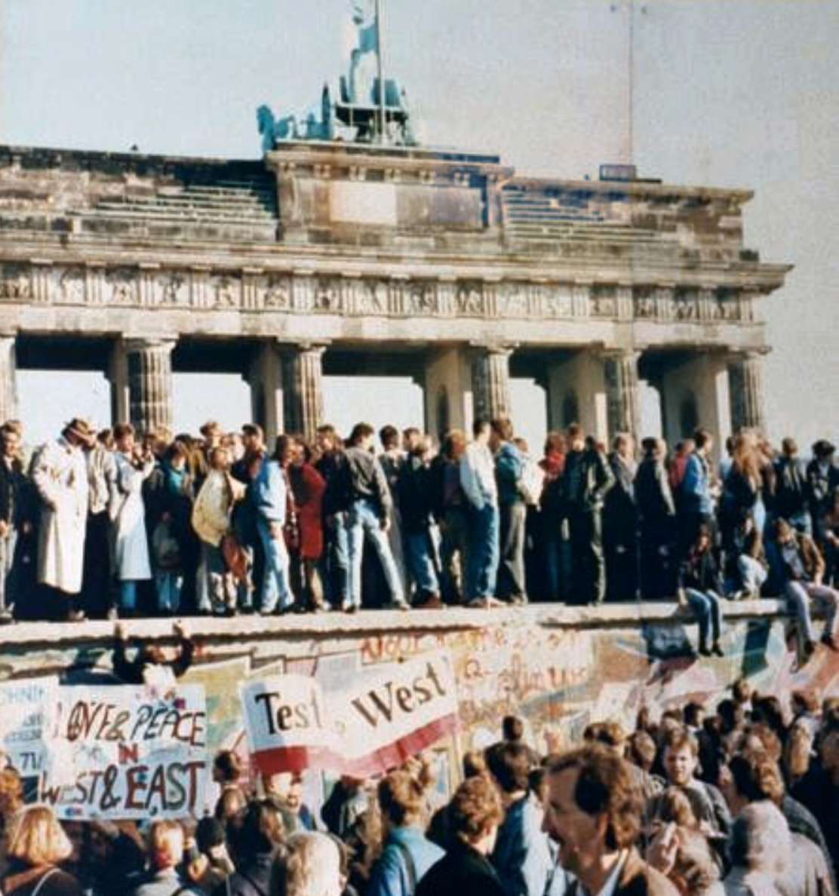
What Was the Proper Political Order?
Fears of “democracy” among American founders:
Madison: “Democracies have ever been spectacles of turbulence and contention... incompatible with personal security or the rights of property... as short in their lives as... violent in their deaths…”
Jefferson: “Gen’l Washington had not a firm confidence in the durability of our government… [& this] had some weight in his adoption of… ceremonies… calculated to prepare us gradually for a change which he believed possible…”
Hamilton: “the British government… best” as the only one “unit[ing] public strength with individual security…”
Adams: The American president should be announced as: “His Highness, the President of the United States, and Protector of the Rights of the Same…”
Question of political order thought settled: first in the rubble of Berlin in 1945, and then in the streets of East Germany in 1991:
Settled in favor of representative democracy, private property, & social insurance—late-1900s liberal democracy
But now reopened? Min Zhu (朱民) to me in 2015: “What are you Americans going to do to fix your broken political system?”

Slide 84
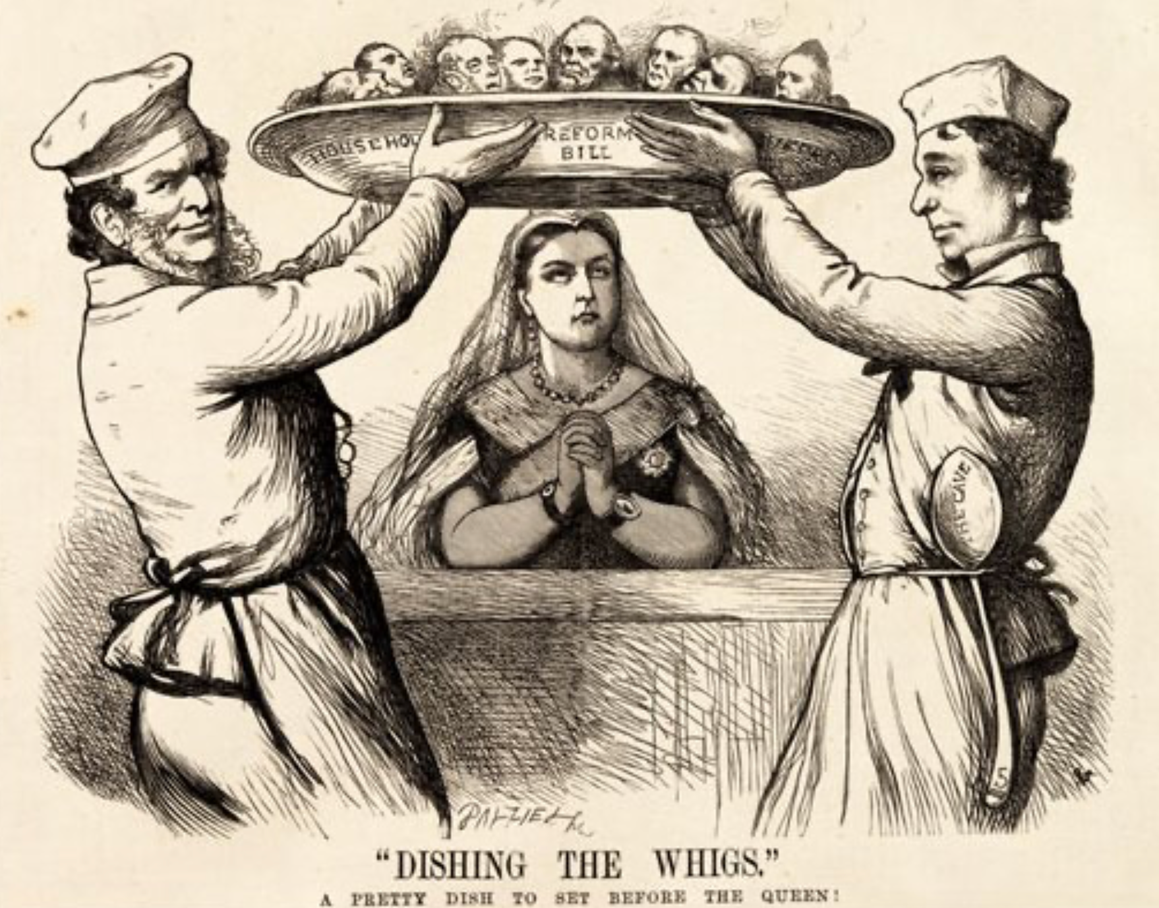
Franchise Restricted to the Rich Could Not Maintain Itself
The dynamic of franchise extension
Liberals in power would try extend on the principle that the new, poorer voters would be less conservative and would support them.
Threatening revolution would lead even conservatives to seek to extend the franchise in order to peel off of the revolutionary coalition those of the disenfranchised who had the most social power:
Earl Grey (yes, the tea): “The Principal… is to prevent… revolution…. I am reforming to preserve, not to overthrow…”
Charismatic leaders with popular followings would seek to give them votes, and then rule via plebiscites—going around the traditional elites
(Peculiar thing about Trump-Johnson: minority, and core is a minority of a minority…)
Conservatives: “dish the Whigs”—opportunities to form winning coalitions by appealing to those who were no profiting from the market economy, or felt that they were losing relative status in some ways…

Slide 85
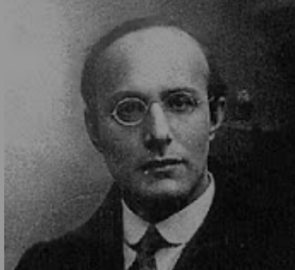
Popular Government and the Market Economy: Society’s Revenge
Karl Polanyi
People believe they have rights—to stable, supportive, nurturing communities; to incomes commensurate with their skills and status; and to money flows that will provide economic stability…
But a market society turns these things—land, labor, and finance—into commodities…
But they are not real commodities, they are fictitious commodities
And so you get your rights only if they satisfy a market profitability test
The only rights a market society respects are property rights:
& the only property rights that are worth anything are those that help you produce things for which rich people have a serious jones
Society will have its revenge: it will protect itself against the market logic, somehow, some way…

Slide 86
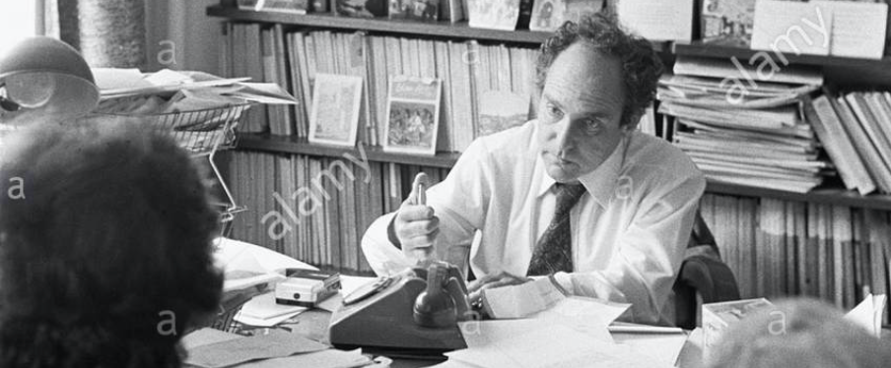


Digression: 5 Thinkers
Who shape my thought about the long 20th century—and how should, I think, shape yours
Beware! They are all deeply flawed…
But they are also geniuses, each in his way…
Beware of their followers! An iron law of ideology: a thinker’s most extravagant and aggressive followers will latch onto the stupidest and most shortsighted and wrong of their doctrines…
In historical order: Marx, Keynes, Hayek, Polanyi, Gellner
The other three thinkers:
Keynes: All that we need to produce general prosperity is technical adjustments to our system. Then the kingdom of freedom and prosperity will be within our grasp—and our major problems will no longer be economic ones
Gellner: The energy that most 19th century thinkers thought would go to “class“ went to “ethnos“ or “umma“ instead. The construction of ideological legitimations that makes sense both to dominants and to submissives who nevertheless believe they are part of some in-group is the key to understanding how societies stabilize themselves
Marx: Only the market economy will focus society’s energy on paying through the nose to boost the economy’s capital stock and to harvest the fruits of science and technology and then deploy them in production. But because the only demands in a market economy that matter are effective demands, the market economy also becomes a more “effective” means of slavery, for private property leads the proletariat to enslave themselves

Slide 87
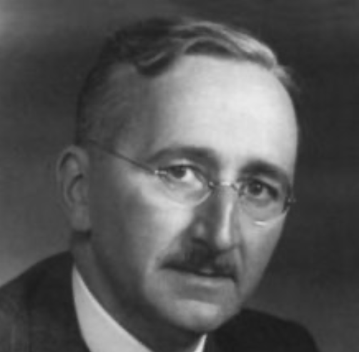
Hayek and Polanyi
Thumbnails on our first two:
Hayek:
Only the market economy can use society’s knowledge.
But the market economy cannot produce “social justice” and should not be asked to try—in fact, we need to recognize that all we can attain is freedom, and that will bring general prosperity, but that justice will be forever outside our reach
Polanyi:
The market economy turns land, labor, and finance into “fictitious commodities”
Society will have its revenge via a “double movement”

Slide 88
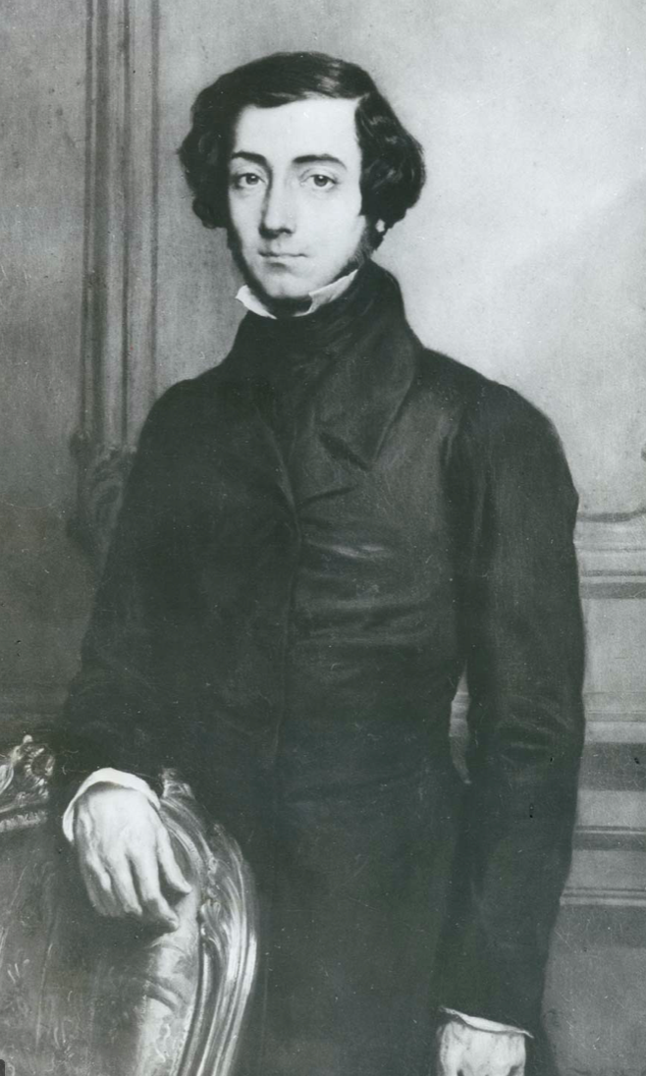
Plus Tocqueville
Toqueville on the rich as “elder brothers” in 1848:
“In the country all the landed proprietors, whatever their origin, antecedents, education or means, had come together, and seemed to form but one class: all former political hatred and rivalry of caste or fortune had disappeared from view. There was no more jealousy or pride displayed between the peasant and the squire, the nobleman and the commoner; instead, I found mutual confidence, reciprocal friendliness, and regard. Property had become, with all those who owned it, a sort of badge of fraternity. The wealthy were the elder, the less endowed the younger brothers; but all considered themselves members of one family, having the same interest in defending the common inheritance. As the French Revolution had infinitely increased the number of land-owners, the whole population seemed to belong to that vast family. I had never seen anything like it, nor had anyone in France within the memory of man…”
“The territorial aristocracy of past ages… [was] obliged… to come to the help of its servants and relieve their distress” no such reciprocal ties of obligation bound the aristocrats of manufactures to their workers: thus “the manufacturing aristocracy which we see rising before our eyes is one of the hardest that have appeared on the earth…”

Slide 89
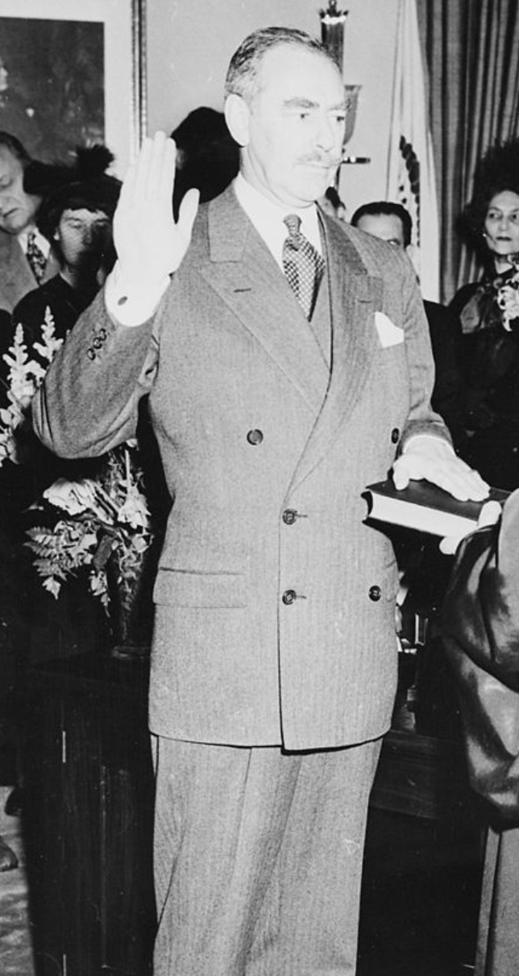
Plus Acheson
Dean Acheson, Secretary of State for Harry S Truman:
On the Republican Party as the party of wealth, enterprise, and opportunity:
“This business base of the Republican Party is stressed not in any spirit of criticism. The importance of business is an outstanding fact of American life. The achievements of business have been phenomenal. It is altogether appropriate that one of the major parties should represent its interests and its point of view…”
The subsequent transformation of the Republican Party from those who were going to become millionaires, or become even greater millionaires; to those who fear that they would lose it all…

Slide 90
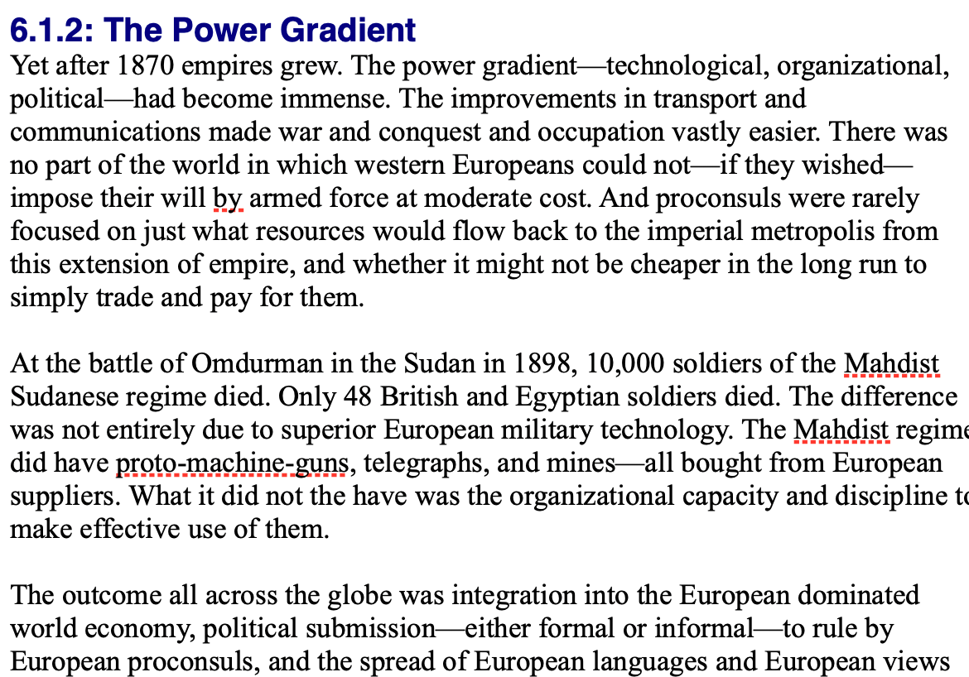
Review: Empire
By 1810 the tide of empire had been clearly ebbing…
But then things turned around: the power gradient:

Slide 91
To Your iClickers!
According to Eichengreen, graphing international capital flows and mobility since 1850 over time produces a graph that is:
V-shaped
U-shaped
W-shaped
An upward line
None of the above

Slide 92
To Your iClickers!
According to Eichengreen, the responsibilities of a pre-World War I central bank as steward of the global gold standard and also as lender-of-last-resort in domestic financial crises were:
in complete harmony
in irresolvable tension
for the most part manageable, before World War I at least, via fancy footwork and good luck
not understood
none of the above

Slide 93
To Your iClickers!
According to Eichengreen, the experience of being on the gold standard for North Atlantic economies in the 1870-1914 period was by and large a happy one, and the experience of countries at the world economy’s periphery was:
also by and large a happy one.
a mixed one.
a source of considerable tension, instability, and political upset.
once again, manageable with fancy footwork and a little good luck.
none of the above.

Slide 94
To Your iClickers!
In Eichengreen’s view, if World War I had somehow been avoided, would the global gold standard have remained stable in the 1920s and 1930s?
There are no guarantees, but probably yes.
There are no guarantees, but probably no.
Certainly not!
Certainly yes—unless several North Atlantic economies experienced a socialist revolution
None of the above.

Slide 95
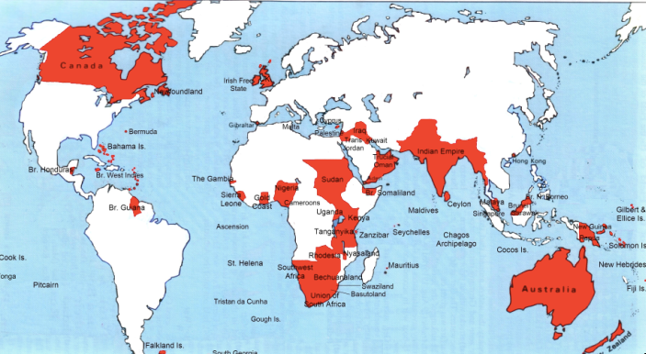
Empire

Slide 96
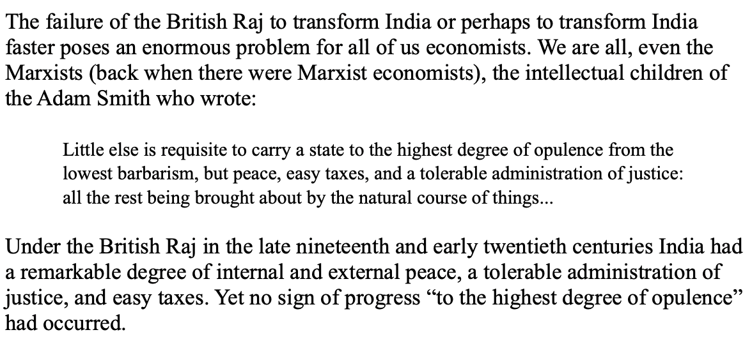
India
Why didn’t the British transform India into an industrial power?

Slide 97
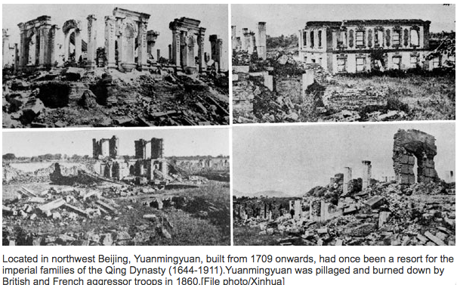
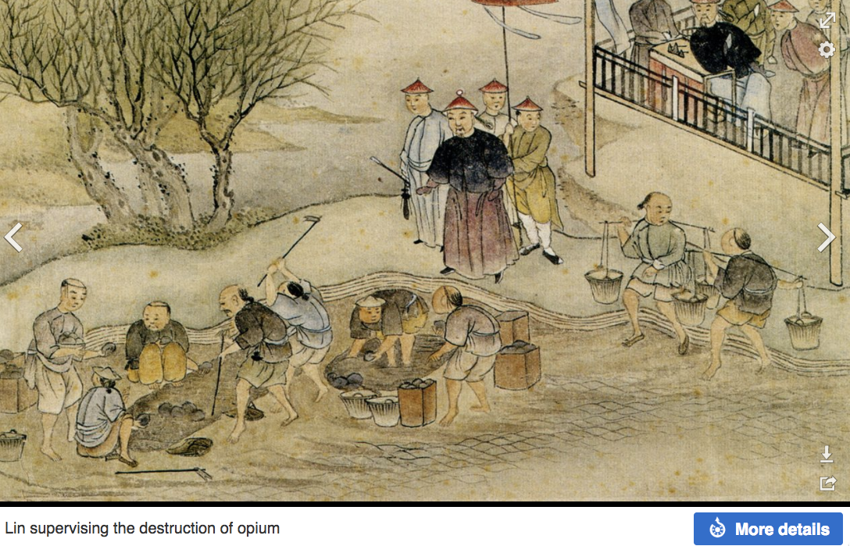
“Self-Strengthening”
The puzzle of China vs. Japan
Great Qing (大清)(1644-1912)
Wu Sangui (吳三桂)
The Rebellion of the Three Feudatories (三藩之亂)
Kangxi and Qianlong: “revere the emperor and expel the barbarians” is difficult to pursue when the emperor and his clan identify themselves as “barbarians”
Tai-Ping Rebellion (太平天國運動)
Cixi ( 慈禧太后)
Li Hongzhang (李鴻章)the Kai-Ping coal mine, Chang Yen-Mao, and Herbert Hoover

Slide 98
Formal Empires
There were, broadly, three views as to why European late-1800s empires rose to such domination, each of which with its own view of what was to be done to fix the situation:
One view is that of John Hobson: The major economic problem was the business cycle. Equipping the military needed to maintain the empire puts people to work. And an empire is a good source of consumers for the products of domestic factories. European governments that pursued empire, Hobson thought, were less likely to face economic distress and so more likely to continue in office.
A second view was that of Joseph Schumpeter: imperialism as the last gasp of military status aristocracy.
The third view was that empires were ordained by God—or at least morally required or desirable, for European powers had a civilizing mission. The Europeans were lucky enough to be the grownups, and it was the obligation of the grownups to civilize the world. But perhaps civilization is best spread by newspapers and books and merchants and engineers, rather than by alien proconsuls? Just a thought.

Slide 99
Informal Empires
But even where Britain (or France, or Germany, or Portugal, or Spain, or those who thought of themselves as descended from the conquistadores of Castile, or Anglo-Saxon settlers) did not rule, they reigned:
Britain seemed successful: playing by Britain’s rules seemed wise…
Britain was powerful: playing by Britain’s rules seemed likely to keep it from getting annoyed…
Britain was working very hard to make itself attractive—to make becoming a Briton-by-proxy of some sort straightforward and profitable in both money and cultural terms…
Britain was the first-mover hegemon: international cooperation was on its terms…

Slide 100
Catch Our Breath…
Comments?
Questions?

Slide 101
Review: Revolutions
“Petty Officer Lemmgen… arrived at the Ministry [of War]… found… Lieutenant HambuRger.... Lemmgen produced a typed document with the following text: ‘Comrades and Workers! The Ebert-Scheidemann government have made themselves impossible.... The undersigned Revolutionary Council has provisionally assumed power.’
“Lieutenant Hamburger inspected the document and became properly indignant. ‘But where are the signatures? Before I can comply with this order, you’ll have to go back and get it properly signed. Otherwise any little shorthand typist could declare the government deposed.’ Petty Officer Lemmgen... saw the logic…. So he and his men saluted... and made their way back to the Revolutionary Council to obtain the necessary signatures....
“But by the time he had obtained the signatures, Lemmgen had learned that the People’s Naval Division had declared itself neutral. So he did not return to the Ministry of War…”

Slide 102
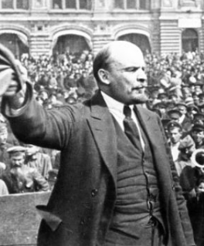
Lenin
A quick power grab…
Confidently expecting a German revolution, and then massive aid…
Brutal civil war
Kerenskyites
Reds
Whites
Nationalists
What was the revolutionary government to do?
Ludendorff’s German war economy…

Slide 103
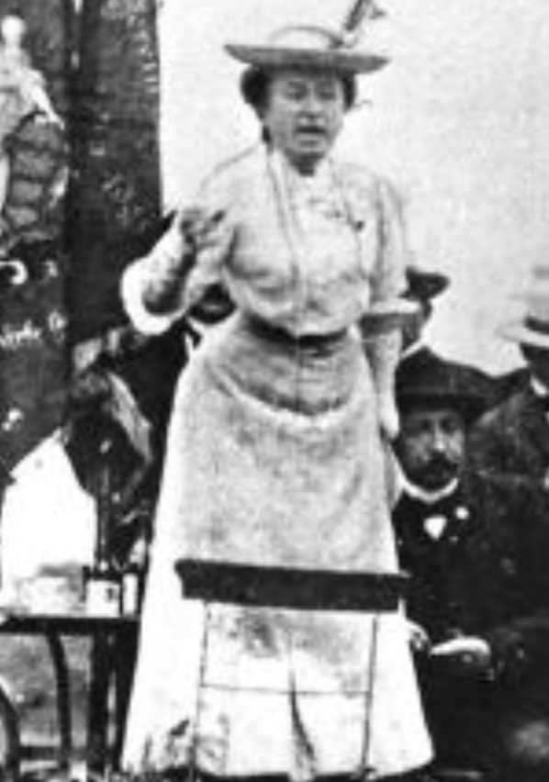
Red Rosa on Lenin
“Without general elections, without unrestricted freedom of press and assembly, without a free struggle of opinion, life dies out in every public institution…. Only the bureaucracy remains…. A few dozen party leaders of inexhaustible energy and boundless experience direct and rule….
“An elite of the working class is invited from time to time to meetings where they are to applaud the speeches of the leaders, and to approve proposed resolutions unanimously–at bottom, then, a clique affair…. Such conditions must inevitably cause a brutalization of public life: attempted assassinations, shooting of hostages, etc…
“Freedom only for the supporters of the government, only for the members of one party–however numerous they may be–is no freedom at all. Freedom is always and exclusively freedom for the one who thinks differently. Not because of any fanatical concept of “justice” but because all that is instructive, wholesome and purifying in political freedom depends on this essential characteristic, and its effectiveness vanishes when ‘freedom’ becomes a special privilege…

Slide 104

Review: The U.S.: The Roaring Twenties
The boom of the 1920s
Mass production—the flowering of the Second Industrial Revolution
“The business of America is business”
Structural changes in the 1920s…

Slide 105
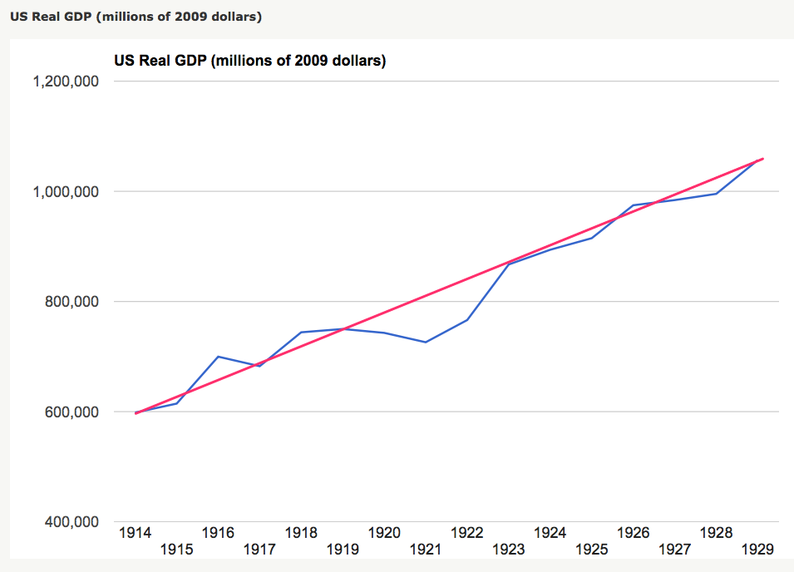
Structural Changes in the 1920s
Mass production—Henry Ford and the Model T
End of mass immigration—immigration restrictions of 1924
What do these do to the demand for construction, and construction workers?
The role of the stock market…
The role of the banking system…

Slide 106
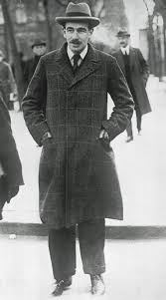
Review: To Your iClickers
John Maynard Keynes thought that the prosperity of the pre-WWI years was:
Natural and stable: a logical development out of human drives that went from strength to strength, and could only be overthrown by a very unlikely disaster.
Artificial and unstable, and based on a very complicated system in which, largely by chance, a lot happened to go right.
Natural but unstable, in that it was a logical development out of humanity’s trading nature but could be disturbed by other human drives—like tribalism, and the lust for domination.
Artificial but stable, as constructed by the greatest minds of the age, and only overthrown by a very unlikely disaster.
None of the above

Slide 107
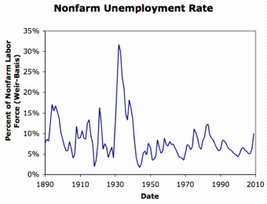
Review: Why the “Perfect Storm” of 1929-1933?
Previous Cycles:
1873—railroad
1884—railroad redux
1893—free silver
1904—Northern Securities
1907—gold drain to Britain
1914—disruption of the start of WWI
1920—deflation; return to “normalcy”
What brought previous downturns to a halt?
What made the Great Depression so great?

Slide 108
General Glut
How is it that there can be a "general glut" in which pretty much every produced commodity and the labor of workers are in excess supply, given that humans are far from satiated with production goods and given that one person's expenditure is another person's income?
Remember: you can take your income and use it either to buy things that are useful or to build up your stock of cash money. If there is excess demand for useful commodities, people can switch from producing whatever they were making to producing whatever is in short supply.
But the only way to build up your stock of cash is to try to cut your spending below your income. And since one person's spending is another person's income, that simply cannot be done in general.
If people in general try, the result is that spending and incomes fall economywide until they are both at such a low level that people de-prioritize building up their cash holdings.

Slide 109
What Had Ended Previous Downturns?
Previous Cycles:
1873—RR investment drops to zero
1884—RR investment drops to zero
1893—confidence that gold standard will be kept
1904—Theodore Roosevelt
1907—J.P. Morgan constitutes himself a pick-up central bank
1914—profits from European war demand WWI
1920—Federal Reserve reverses course

Slide 110
Interwar Gold Standard
The interwar gold standard caused, deepened, and definitely did nothing toward curing or ameliorating the Great Depression?
There is nothing worse than attempting to credibly commit to an incredible policy
The fear that the gold standard would break down caused people to want to hoard cash—to build up their cash holdings.
The fear that the gold standard would break down caused governments to be extremely unwilling to boost their economies' cash supplies—such boosts might, governments feared, undermine confidence that their country would stay on the gold standard.
Big depressions happen when the popular demand for cash outstrips the government's supply
The interwar gold standard was thus a powerful motivator and stage-setter pushing both people and governments into the patterns of behavior that produced the Great Depression

Slide 111

“Crying ‘Fire! Fire!’ in Noah’s Flood…”
France gold acquisition policy
American gold acquisition policy
The weakness of the gold-exchange standard—that people knew the gold standard could and would be abandoned
Labor-side pressure…
Nothing worse than an attempt to credibly commit to an incredible policy…
And then the belief that inflation was always just around the corner…

Slide 112

The Role of the Stock Market
Stock market doubles between the start of 1927 and late 1929
Positive-feedback margin trading
And a large number of people coming into the market who do not understand what is going on
Castles in the air
Prohibition?
Monetary policy?
Mass production?
The expectations shock produced

Slide 113
Why Was the Great Depression so Great?
John Maynard Keynes:
“When once the recovery has been started, the manner in which it feeds on itself and cumulates is obvious. But during the downward phase, when both fixed capital and stocks of materials are for the time being redundant and working-capital is being reduced, the schedule of the marginal efficiency of capital may fall so low that it can scarcely be corrected, so as to secure a satisfactory rate of new investment, by any practicable reduction in the rate of interest.
“Thus with markets organised and influenced as they are at present, the market estimation of the marginal efficiency of capital may suffer such enormously wide fluctuations that it cannot be sufficiently offset by corresponding fluctuations in the rate of interest. Moreover, the corresponding movements in the stock-market may, as we have seen above, depress the propensity to consume just when it is most needed. In conditions of laissez-faire the avoidance of wide fluctuations in employment may, therefore, prove impossible without a far-reaching change in the psychology of investment markets such as there is no reason to expect.
“I conclude that the duty of ordering the current volume of investment cannot safely be left in private hands….”

Slide 114

The Role of the Banking System
In the United States in the 1920s, about 600 banks failed a year—largely small rural banks
But banks set out to make riskier and riskier loans
Do they count on rescue from the Federal Reserve?
And when the Great Depression hits, bank failures rise to previously-unimaginable heights
Is there anything that could do more to boost the demand for or reduce the supply of cash?
And so call forth a general glut?
Lenders of “last resort”?

Slide 115
The Presumption Before the Great Depression
The presumption before the Great Depression that the government was not responsible for managing and curing the business cycle…
Two strands reinforced each other.
The first was the strength of the idea of laissez-faire: that government (protecting property and enforcing contracts aside) was overwhelmingly a problem and not a solution. As John Maynard Keynes wrote in his essay The End of Laissez-Faire, a powerful drive behind that was: “the corruption and incompetence of eighteenth-century government…. Almost everything which the State did in the eighteenth century in excess of its minimum functions was, or seemed, injurious or unsuccessful. [And] on the other hand, material progress between 1750 and 1850 came from individual initiative…”
The second was social Darwinism—that, in the words of steelmaster Andrew Carnegie, the second-richest man in America circa 1905 and a man who gave away his entire fortune: “The price we pay for [our civilization]... is, no doubt, great.... The employer of thousands is forced into the strictest economies... [in] the rates paid to labor.... The law of competition... is here; we cannot evade it; no substitutes for it have been found; and while the law may be sometimes hard for the individual, it is best for the race, because it insures the survival of the fittest in every department..."
The result was a dominant belief—at least among the rich and powerful—that:
The market giveth, the market taketh away: blessed be the name of the market.

Slide 116
The Hoover Administration’s Reaction to the Great Depression
The 1929-1933 Hoover administration believed that little could be done.
That the only good things that could be done were to (a) repeatedly state that "prosperity is just around the corner" and (b) try to cut federal government spending and raise taxes in order to restore confidence and scotch the fear of high inflation.
As economist R.G. Hawtrey wrote, to worry about inflation in the midst of the Great Depression was like "crying 'FIRE! FIRE!' in Noah's Flood..."
Herbert Hoover himself wrote afterwards about how his administration had been dominated by the "'leave-it-alone liquidationists' headed by Secretary of the Treasury Mellon, [who] felt that government must keep its hands off and let the slump liquidate itself. Mr. Mellon had only one formula:
'Liquidate labor, liquidate stocks, liquidate the farmers, liquidate real estate'. He held that even panic was not altogether a bad thing. He said: 'It will purge the rottenness out of the system. High costs of living and high living will come down. People will work harder, live a more moral life. Values will be adjusted, and enterprising people will pick up the wrecks from less competent people'…"
Hoover went on to state that he did not share this view…
That raises lots of questions about how his administration worked…

Slide 117
To Your iClickers
The largest automobile manufacturer in the world in 1928 was:
Toyota
Daimler-Benz
Peugeot
Ford
General Motors

Slide 118
To Your iClickers…
Worldwide, the Great Depression was was:
In relative terms, equalled by the Cleveland Depression of 1893-6
In relative terms, smaller than the depression that followed the Crash of 1873
In relative terms, equalled by the Great Recession of 2008-2020
In relative terms, by far the largest depression ever
None of the above

Slide 119

Review: New Deals
Japan: Takahashi Korekiyo
moved early to maintain full employment
Britain: MacDonald-Snowden-Baldwin
Forced off…
Germany: Adolf Hitler
Succeeds Bruening
America: Franklin Delano Roosevelt
Succeeds Herbert Hoover
France: Leon Blum

Slide 120
Recovery
Japan recovered the fastest,
Germany second,
Britain third,
The U.S. fourth,
France last.
By-and-large, the sooner you abandon the gold standard, expand the money supply, and undertake a "New Deal" to boost government spending, the better…

Slide 121
The Polanyian Perplex
People believe that the rights they have are broader and deeper than simply property rights, but the market economy disagrees.
Thus either governments will find a way to guarantee their populations these extra rights to community stability, general prosperity, and full employment, or society will react somehow against the liberal market-oriented political-economic system.
“Fictitious commodities”:
Land
Labor
Finance
Society’s “double movement”

Slide 122
The Permanent Problem of the Human Race
John Maynard Keynes thought that the economic problem would not be the "major problem of the human race"
By the end of the twentieth century the human race would be so rich that people would be practically satiated with commodities.
Thus the "economic problem" of how to economize and be efficient, and allocate scarce means among alternative uses, was not the permanent problem of the human race.
Instead, "for the first time since his creation man will be faced with his real, his permanent problem-how to use his freedom from pressing economic cares, how to occupy the leisure, which science and compound interest will have won for him, to live wisely and agreeably and well.... It will be those peoples, who can keep alive, and cultivate into a fuller perfection, the art of life itself and do not sell themselves for the means of life, who will be able to enjoy the abundance when it comes..."
Yet Keynes was not sure that having to confront this problem would be a net plus for humanity: "Will this be a benefit? If one believes at all in the real values of life, the prospect at least opens up the possibility of benefit. Yet I think with dread of the readjustment of the habits and instincts of the ordinary man, bred into him for countless generations, which he may be asked to discard within a few decades..."

Slide 123
Digression: How to Study
Will I ask you about Jan Christian Smuts? About the prayer (and theology) of the Grigua?
No…
Themes and concepts…
But you need narratives and stories to hang onto them…
And our brains are very good at deep-sixing useless information
Andy Matuschak: Why Books Don’t Work <https://andymatuschak.org/books/>:
“Picture some serious non-fiction tomes. The Selfish Gene; Thinking, Fast and Slow; Guns, Germs, and Steel; etc.
“Have you ever had a book like this—one you’d read—come up in conversation, only to discover that you’d absorbed what amounts to a few sentences? I’ll be honest: it happens to me regularly. Often things go well at first. I’ll feel I can sketch the basic claims, paint the surface; but when someone asks a basic probing question, the edifice instantly collapses. Sometimes it’s a memory issue: I simply can’t recall the relevant details. But just as often, as I grasp about, I’ll realize I had never really understood the idea in question, though I’d certainly thought I understood when I read the book. Indeed, I’ll realize that I had barely noticed how little I’d absorbed until that very moment. I know I’m not alone here…

Slide 124
Skipped Topic: Pre-1914 Political Economy: Over in Europe
The June Days of 1848 in Paris:
Tocqueville:
“The insurrection of June [1848]... class against class... a blind and rude, but powerful, effort on the part of the workmen to escape from the necessities of their condition, which had been depicted to them as one of unlawful oppression…. The closing of the national workshops… occasioned the rising…”
“Thousands… hastening to our aid from every part of France.... Thanks to the railroads, some had already come from fifty leagues’ distance... every class of society... peasants... shopkeepers... landlords and nobles all mingled together... they rushed into Paris with unequalled ardour: a spectacle as strange and unprecedented in our revolutionary annals.... The insurgents received no reinforcements, whereas we had all France for reserves…”

Slide 125
French Politics
Régimes stability is not on the menu:
the terrorist dictatorship of the Jacobins (the mainspring of popular government… amid revolution it is at once virtue and terror: virtue, without which terror is fatal; terror, without which virtue is impotent…)
a corrupt and gerrymandered 5-man executive of the Directory, defended on October 5, 1795 by the “whiff of grapeshot” of Napoleon Bonaparte and Joachim Murat, that managed to generate the first modern hyperinflation, defended itself against a royalist coup plotted by two of its five members (Barthelemy and Carnot) and its most successful general (Pichegru), and was then overthrown by the same Napoleon in 1799.
a dictatorship, with Napoleon Bonaparte as “First Consul”, until 1804.
an empire, with Napoleon Bonaparte as Emperor of the French, until suppressed by the other European powers in 1815.
a restored Bourbon monarchy, with first Louis XVIII and then Charles X, until 1830.
an alternative Orleanist monarchy, with King Louis-Philippes as the king-citizen, overthrown in 1848.
a second republic, overthrown by its own president, Napoleon’s nephew Louis Napoleon, which collapsed under pressure of military defeat in 1870.
a socialist commune, in Paris at least.
a third republic, which suppressed the commune—but promptly chose a royalist Marshal MacMahon, as president.
a failed attempt by third republic president Marshal MacMahon to replace himself by a King Henry V.
a failed attempt by the ex-Minister of War Georges Boulanger to seize power for his RRR movement: Revanche, Révision, Restauration (revenge on Germany, revision of the constitution, restoration of the monarchy).

Slide 126
Left-Wing Normal European Politics I
Disjunction between policies and rhetoric:
The Socialist Party of Germany’s Erfurt and Gotha programs seek things like: holidays for elections, two-year legislative terms, the right to bear arms, equal rights for women, the prohibition of spending public funds for religious purposes, free public schools and colleges, free medical care including midwifery, an eight-hour working day, no child labor under 14, a 36-hour minimum weekend, an occupational safety and health administration…

Slide 127
Left-Wing Normal European Politics II
Disjunction between policies and rhetoric:
But also: “By every lawful means to bring about a free state and a socialistic society, to effect the destruction of the iron law of wages by doing away with the system of wage labor.” And they sought: “the transformation of the capitalist private ownership of the means of production—land and soil, pits and mines, raw materials, tools, machines, means of transportation—into social property and the transformation of the production of goods into socialist production carried on by and for society.” And they believed: “This… emancipation… of the entire human race…. But it can only be the work of the working class, because all other classes… have as their common goal the preservation of the foundations of contemporary society.”

Slide 128
Center and Right-Wing Normal European Politics
The touchstone was “fairness”: it was not fair that those who did not work hard and did not play by the rules got lots of good things:
Those who did not play by the rules could be on either end of the wealth-and-power spectrum:
Parasitic aristocrats and cruel plutocrats
Those poor who wanted something for nothing, or got above their station
A middle-class, social order movement
Focus voters’ attention on the disruptive utopian aspirations of the left, and electoral coalitions could be preserved…
Preserve as much as possible of old orders of hierarchy in changing times:
Reform to preserve; change so things could stay the same
Find new reasons why hierarchy is good: social darwinism

Slide 129
Magnifying Non-Economic Cleavages Had Dangers
Society under threat not by economic inequality but by social disorder—or aliens—or other nations. Plus:
A right-wing landed and bureaucratic upper class that had, by and large, lost its social role.
A belief by politicians anxious to paper over class divisions that they could be papered over with national or ethnic unity.
A growing social-darwinist current that struggle was good, and the victors should be rewarded
Even or especially military struggle by peoples-in-arms, over not what language a province would be administered in but who would live there
These stored up trouble as 1914 approached.
In 1919 John Maynard Keynes was to write, bitterly, that he, his peers, and his elders had regarded:
“the projects and politics of militarism and imperialism, of racial and cultural rivalries, of monopolies, restrictions, and exclusion, which were to play the serpent to this paradise… [as] little more than the amusements of his daily newspaper…”

Slide 130

Skipped Topic: Passing the Baton: From Britain to America
The Industrial Revolution took place in Britain
The standard explanation four or five largely independent strands coming together.:
Limited government, security of property, and freedom of contract
Science and the technological tradition of sustained inquiry
Victory in the wars of the Commercial Revolution era
Machinery making, "tinkering", and "gadgets"—primarily made out of metal.
Coal in Britain—the only thing that made a steam engine potentially profitable.
Plus high elasticity of demand for leading-sector products…
http://bradford-delong.com brad.delong@gmail.com

Slide 131
iClickers: Why Breaktrhrough?
The principal reason that the Industrial Revolution took place in late eighteenth century Britain (rather than in Sung China, or Abbasid Baghdad, or Antonine Dynasty Rome, or during the Hellenistic Age) is:
A lack of human numbers thinking about problems of production
A lack of good means of communication—e.g. printing—for diffusing information about how to solve problems of production
A lack of experience using coal as an energy source
A lack of the incentive created by high real wages leading to a strong desire to make labor more productive
None of the above/not enough information
http://bradford-delong.com brad.delong@gmail.com

Slide 132
iClicker: Why Passing the Baton
The principal reason that the twentieth century was an American rather than a second British century was:
The United States’s aggressive and enthusiastic welcome of immigrants
The United States’s focus on broad-based technical education
The United States’s extraordinary abundance of natural resources driving high real wages and enormous incentives to build machines to manipulate matter
A U.S. government that took industrial development as a key policy goal, rather than being comfortable with laissez-faire
None of the above/not enough information
http://bradford-delong.com brad.delong@gmail.com

Slide 133

British Productivity Growth Acceleration
http://bradford-delong.com brad.delong@gmail.com

Slide 134

But Even in the First Half of the Nineteenth Century the U.S. Was Outpacing Britain in Growth…
Even in the first half of the nineteenth century—the period in which the British Industrial Revolution made it the wonder of the world—economic growth in the United States was proceeding faster than in Britain.
While British real GDP per capita was increasing at less than 0.6 percent per year
American was growing at a hair over one percent per year.
And a significantly larger share of GDP was going to the white working class in the United States, in the north at least:
The extraordinary abundance of land and the possibility of "lighting out for the territory", in the words of American author Mark Twain, gave even workers without property or notably scarce skills substantial economic bargaining power.
http://bradford-delong.com brad.delong@gmail.com

Slide 135
And Starting in the Late Nineteenth Century
Second Industrial Revolution…
Why the U.S. and Germany, and not Britain?
Immigration and Population
Was resource scarcity no longer a factor?
Was the differential in the growth rate h of the stock of useful economic knowledge even greater than the differential in the growth rate g of the efficiency-of-labor?
http://bradford-delong.com brad.delong@gmail.com

Slide 136
Phases of American Growth
1.0% per year in GDP per capita from 1760-1860: resource abundance
1.6% per year in GDP per capita from 1860-1929:
“Great traverse”: K/Y ratio up from 2.5 to 4
Half of it an increase in savings rates
Half of it a fall in the price of capital goods
2.5% per year in GDP per capita from 1929-1973
“Fordism”
Expected further acceleration: it did not happen
Post-1973
Productivity slowdown 1973-1995 (environment, oil, baby boom, feminism)
“New economy” 1995-2006
Post-2006 collapse of growth
http://bradford-delong.com brad.delong@gmail.com

Slide 137

American Productivity Growth Acceleration
http://bradford-delong.com brad.delong@gmail.com

Slide 138

Early Nineteenth Century: Westward Expansion
Westward expansion
The “American System”
Abundant natural resources
Very high real wages
Focus on raising labor productivity
Hence fast efficiency-of-labor growth
Britain, by contrast, focused on economizing on (non-coal) raw materials
http://bradford-delong.com brad.delong@gmail.com

Slide 139
The Importance of Resources 1760-1860
Major westward expansion and "Amerindian removal”
The century 1760 to 1860 before the Civil War.
We have U.S. output-per-worker growth then at about 1.0% per year…
…in contrast to British output-per-worker growth at about 0.5% per year.
We have the U.S. population and labor force growing at 2.5% per year…
…from 2.5 to 30 million.
http://bradford-delong.com brad.delong@gmail.com

Slide 140


The Importance of Resources 1760-1860
Recall our basic Solow Model:
http://bradford-delong.com brad.delong@gmail.com

Slide 141

The Importance of Resources 1760-1860
Recall our basic Solow Model:
Assume K/Y constant, so the growth rate g of the efficiency of labor and the growth rate of output-per-worker are the same:
http://bradford-delong.com brad.delong@gmail.com

Slide 142
The Importance of Resources 1760-1860
Recall our basic Solow Model:
Assume K/Y constant, so the growth rate g of the efficiency of labor and the growth rate of output-per-worker are the same:
http://bradford-delong.com brad.delong@gmail.com

Slide 143
The Importance of Resources 1760-1860
Recall our basic Solow Model:
Assume K/Y constant, so the growth rate g of the efficiency of labor and the growth rate of output-per-worker are the same:
Let’s, last, fit this to history in the century before the 1860 election of President Abraham Lincoln and the ensuing American Civil War:
http://bradford-delong.com brad.delong@gmail.com

Slide 144

The Importance of Resources 1760-1860
Recall our basic Solow Model:
Assume K/Y constant, so the growth rate g of the efficiency of labor and the growth rate of output-per-worker are the same:
Let’s, last, fit this to history in the century before the 1860 election of President Abraham Lincoln and the ensuing American Civil War:
http://bradford-delong.com brad.delong@gmail.com

Slide 145

Westward Expansion
http://bradford-delong.com brad.delong@gmail.com

Slide 146

The Importance of Resources 1760-1860
We have two parameters left: γ and h, the weight of ideas in efficiency-of-labor growth and the rate of growth of the stock of useful ideas for the economy in American heads, respectively:
http://bradford-delong.com brad.delong@gmail.com

Slide 147

The Importance of Resources 1760-1860
We have two parameters left: γ and h, the weight of ideas in efficiency-of-labor growth and the rate of growth of the stock of useful ideas for the economy in American heads, respectively:
http://bradford-delong.com brad.delong@gmail.com

Slide 148
The Importance of Resources 1760-1860
Thus if γ→∞ then h→0.010
http://bradford-delong.com brad.delong@gmail.com

Slide 149
The Importance of Resources 1760-1860
Thus if γ→∞ then h=0.010
Thus if γ=3.0 then h=0.00667
http://bradford-delong.com brad.delong@gmail.com

Slide 150
The Importance of Resources 1760-1860
Thus if γ→∞ then h=0.010
Thus if γ=3.0 then h=0.00667
Thus if γ=1.0 then h=0.00
http://bradford-delong.com brad.delong@gmail.com

Slide 151
The Importance of Resources 1760-1860
Thus if γ→∞ then h=0.010
Thus if γ=3.0 then h=0.00667
Thus if γ=1.0 then h=0.00
Looking across the Atlantic Ocean to Great Britain, we see that over there it is indeed the case that h=0.005 from 1760 to 1860. Faster growth of h in America due to some catchup with the world's first and leading industrial nation seems likely. So γ=3.0 has some claim to be the most likely value…
http://bradford-delong.com brad.delong@gmail.com

Slide 152
A Counterfactual
The Royal Proclamation of October 1763:
Our Royal Will and Pleasure… no... Governor or Commander in Chief in... our... Colonies or Plantations in America do... grant Warrants of Survey, or pass Patents for any Lands beyond the Heads or Sources of any of the Rivers which fall into the Atlantic Ocean from the West and North West, or upon any Lands whatever, which, not having been ceded to or purchased by Us as aforesaid, are reserved to the said Indians, or any of them...
http://bradford-delong.com brad.delong@gmail.com

Slide 153

What If This Royal Proclamation Had Stuck?
What if ρ=0?
If γ → ∞ and h=0.010 then g=0.01
If γ=3.0 and h=0.00667 then g=−0.00125
If γ=1.5 and h=0.000 then g=−0.01
http://bradford-delong.com brad.delong@gmail.com

Slide 154
What If This Royal Proclamation Had Stuck?
What if ρ=0?
If γ → ∞ and h=0.010 then g=0.01
If γ=3.0 and h=0.00667 then g=−0.00125
If γ=1.5 and h=0.000 then g=−0.01
An America penned behind the Appalachians would probably have seen its living standards and productivity levels not growing at 1% per year from 1760 to 1860 but shrinking.
For γ=3.0, living standards and productivity levels would have shrunk at a pace of -0.125% per year
http://bradford-delong.com brad.delong@gmail.com

Slide 155
What If This Royal Proclamation Had Stuck?
What if ρ=0?
Of course, a poorer America would probably have seen fewer immigrants.
But it might not have seen that many fewer immigrants.
It would no longer have been quite as attractive to move from Britain to America over 1760 to 1860.
But it still would have been very attractive to move from France, Germany, Scotland—or most of all from Potato Blight-ridden Ireland...
In what other ways might this counterfactual alternate-history "little America" would likely have been different in 1860 than America actually was?
http://bradford-delong.com brad.delong@gmail.com

Slide 156

“Trail of Tears’
http://bradford-delong.com brad.delong@gmail.com

Slide 157
A large chunk of America's pre-1860 visible growing prosperity was based not just on African-American slavery, but also on "Amerindian removal"
http://bradford-delong.com brad.delong@gmail.com

Slide 158
Catch Our Breath…
Ask me two questions…
Make two comments…

Slide 159

Late Nineteenth-Early Twentieth Century: “Great Traverse”
Invention of the industrial research lab
First globalization
Technologies of Second Industrial Revolution
Economies of scale and mass production
Falling price of capital goods
Greater savings effort
Plus mass immigration
Rapidly rising inequality
Or was it? Emancipation…
http://bradford-delong.com brad.delong@gmail.com

Slide 160
Capital Deepening
Lowered deprecation rate δ
From 5% to 3% per year
http://bradford-delong.com brad.delong@gmail.com

Slide 161
Capital Deepening
Lowered deprecation rate δ
From 5% to 3% per year
Increased savings rate s
Capital-output ratio goes from 2.5 to 4 across 70 years
http://bradford-delong.com brad.delong@gmail.com

Slide 162
Capital Deepening
Lowered deprecation rate δ
From 5% to 3% per year
Increased savings rate s
Capital-output ratio goes from 2.5 to 4 across 70 years
with an α=1, output-per-worker proportional to the capital-output ratio
ln(4/2.5)/70 = 0.007
g = 0.9%/year
http://bradford-delong.com brad.delong@gmail.com

Slide 163
Capital Deepening
Capital-output ratio goes from 2.5 to 4 across 70 years
with an α=1, output-per-worker proportional to the capital-output ratio
ln(4/2.5)/70 = 0.007
g = 0.9%/year
Second Industrial Revolution
Large managerial corporation
Large-scale investment banking
Industrial research lab
Continent-wide market
Globalization
http://bradford-delong.com brad.delong@gmail.com

Slide 164

Mid Twentieth Century: Drive to High Mass Consumption
DARPA, etc.: two heads are better than one
“Fordist” oligopolies
Second globalization
Keynesian stabilization policies
Falling and then low inequality
For white guys…
http://bradford-delong.com brad.delong@gmail.com

Slide 165
Mid Twentieth Century: Drive to High Mass Consumption
DARPA, etc.: two heads are better than one
“Fordist” oligopolies
Second globalization
Keynesian stabilization policies
Falling and then low inequality
For white guys…
http://bradford-delong.com brad.delong@gmail.com

Slide 166
Catch Our Breath…
Ask me two questions…
Make two comments…

Slide 167
Notes

